Slide 1



EMIS meet District Directors, CESs and Circuit Managers
F Kok
EMIS
June 2019

Slide 2
1173 Schools
60% of schools is submitting data on time
90% after two weeks

Slide 3
General Information on SA-SAMS
Correct detail of school is required:
School e-mail address
Principal or Acting Principal
School Telephone number
Principal Cell number – Only given to high ranking officials – not given to public. Guided by the (POPI act)
Often officials (MEC’s Office complain that the schools’ telephone numbers no longer work (data not updated)
spaces ,www, commas in e-mail addresses

Slide 4
Schools without e-mail addresses
Latest Import All Years
Computer | EMail | District5 | SchoolName | ImportMonth | DCNAME | Town:
445203174 |  | DC16 | BOKAMOSO/IKAMVA IF/S | 5 | XHARIEP | Zastron
440907207 |  | DC17 | REAMOHETSWE PF/S | 5 | MOTHEO | CLOCOLAN
440808009 |  | DC18 | HARTBEESDRAAI PF/S | 5 | LEJWELEPUTSWA | BULTFONTEIN
440808137 |  | DC18 | LA RIVIERA PF/S | 5 | LEJWELEPUTSWA | BULTFONTEIN
440808178 |  | DC18 | ONS SIN PF/S | 5 | LEJWELEPUTSWA | BULTFONTEIN
442008207 |  | DC18 | ORANJEKUIL PF/S | 5 | LEJWELEPUTSWA | HOOPSTAD
444908236 |  | DC18 | RAPPARDSVLAKTE PF/S | 5 | LEJWELEPUTSWA | WESSELSBRON
440808142 |  | DC18 | SARDINIA PF/S | 5 | LEJWELEPUTSWA | BULTFONTEIN
442908145 |  | DC18 | THABANG PF/S | 5 | LEJWELEPUTSWA | ODENDAALSRUS
444908181 |  | DC18 | VOLSTRUISPAN PF/S | 5 | LEJWELEPUTSWA | WESSELSBRON
444908054 |  | DC18 | WILLENDANK PF/S | 5 | LEJWELEPUTSWA | WESSELSBRON
440506123 |  | DC18 | WINKELPOS PF/S | 5 | LEJWELEPUTSWA | KROONSTAD

Slide 5
vw_LatestImportAllYears
Computer | EMail | District5 | SchoolName | ImportMonth | DCNAME
440101086 |  | DC19 | AASVOëLKRANS PF/S | 5 | THABO MOFUTSANYANA
442807286 |  | DC19 | BELLONA PF/S | 5 | THABO MOFUTSANYANA
440101173 |  | DC19 | BOHLOKWA PF/S | 5 | THABO MOFUTSANYANA
441501026 |  | DC19 | CAROLINA PF/S | 5 | THABO MOFUTSANYANA
443410113 |  | DC19 | HESTERDAL PF/S | 5 | THABO MOFUTSANYANA
441407071 |  | DC19 | KETA PF/S | 5 | THABO MOFUTSANYANA
440101147 |  | DC19 | KWALENT PF/S | 5 | THABO MOFUTSANYANA
440101068 |  | DC19 | LELONG PF/S | 5 | THABO MOFUTSANYANA
441811142 |  | DC19 | LERATO PF/S | 5 | THABO MOFUTSANYANA
441501009 |  | DC19 | MAGDALENA PF/S | 5 | THABO MOFUTSANYANA
443701175 |  | DC19 | MAKWANYANE PF/S | 5 | THABO MOFUTSANYANA
440101184 |  | DC19 | MAMOJALEFA PF/S | 5 | THABO MOFUTSANYANA
441501130 |  | DC19 | MASHAYENG PF/S | 5 | THABO MOFUTSANYANA
440101203 |  | DC19 | MEETS PF/S | 5 | THABO MOFUTSANYANA
440101075 |  | DC19 | MERWESHOOP PF/S | 5 | THABO MOFUTSANYANA
441501221 |  | DC19 | MEYNELL PF/S | 5 | THABO MOFUTSANYANA
440101154 |  | DC19 | MISPA PF/S | 5 | THABO MOFUTSANYANA
440101160 |  | DC19 | MOLEBOHE PF/S | 5 | THABO MOFUTSANYANA
443410204 |  | DC19 | OOSTHUIZENSHOEK PF/S | 5 | THABO MOFUTSANYANA
443410331 |  | DC19 | PHALLA PF/S | 5 | THABO MOFUTSANYANA
440101131 |  | DC19 | PIETERSHOF PF/S | 5 | THABO MOFUTSANYANA
443410176 |  | DC19 | POMMERN PF/S | 5 | THABO MOFUTSANYANA
442710325 |  | DC19 | RAMAELE PF/S | 5 | THABO MOFUTSANYANA
440101116 |  | DC19 | REDUMETSE PF/S | 5 | THABO MOFUTSANYANA
443410230 |  | DC19 | RONDEBOSCH PF/S | 5 | THABO MOFUTSANYANA
441407033 |  | DC19 | SEFOMELA PF/S | 5 | THABO MOFUTSANYANA
443410180 |  | DC19 | SEKHAAHLA PF/S | 5 | THABO MOFUTSANYANA
443410112 |  | DC19 | SUSANNASKOP PF/S | 5 | THABO MOFUTSANYANA
443410335 |  | DC19 | SWARTBERG PF/S | 5 | THABO MOFUTSANYANA
440101029 |  | DC19 | THABO PF/S | 5 | THABO MOFUTSANYANA
441407128 |  | DC19 | VAILIMA PF/S | 5 | THABO MOFUTSANYANA
441501111 |  | DC19 | WELVANPAS PF/S | 5 | THABO MOFUTSANYANA
440101141 |  | DC19 | YEDDO PF/S | 5 | THABO MOFUTSANYANA

Slide 6
vw_LatestImportAllYears
Computer | EMail | District5 | SchoolName | Import Month | DCNAME | Town:
443410204 |  | DC19 | OOSTHUIZENSHOEK PF/S | 5 | THABO MOFUTSANYANA | REITZ
443410331 |  | DC19 | PHALLA PF/S | 5 | THABO MOFUTSANYANA | REITZ
440101131 |  | DC19 | PIETERSHOF PF/S | 5 | THABO MOFUTSANYANA | BETHLEHEM
443410176 |  | DC19 | POMMERN PF/S | 5 | THABO MOFUTSANYANA | REITZ
442710325 |  | DC19 | RAMAELE PF/S | 5 | THABO MOFUTSANYANA | LINDLEY
440101116 |  | DC19 | REDUMETSE PF/S | 5 | THABO MOFUTSANYANA | BETHLEHEM
443410230 |  | DC19 | RONDEBOSCH PF/S | 5 | THABO MOFUTSANYANA | REITZ
441407033 |  | DC19 | SEFOMELA PF/S | 5 | THABO MOFUTSANYANA | FICKSBURG
443410180 |  | DC19 | SEKHAAHLA PF/S | 5 | THABO MOFUTSANYANA | REITZ
443410112 |  | DC19 | SUSANNASKOP PF/S | 5 | THABO MOFUTSANYANA | REITZ
443410335 |  | DC19 | SWARTBERG PF/S | 5 | THABO MOFUTSANYANA | REITZ
440101029 |  | DC19 | THABO PF/S | 5 | THABO MOFUTSANYANA | BETHLEHEM
441407128 |  | DC19 | VAILIMA PF/S | 5 | THABO MOFUTSANYANA | FICKSBURG
441501111 |  | DC19 | WELVANPAS PF/S | 5 | THABO MOFUTSANYANA | FOURIESBURG
440101141 |  | DC19 | YEDDO PF/S | 5 | THABO MOFUTSANYANA | BETHLEHEM

Slide 7
vw_LatestImportAllYears
Computer | EMail | District5 | SchoolName | ImportMonth | DCNAME | Town:
442506027 |  | DC20 | BURMAH PF/S | 5 | FEZILE DABI | EDENVILLE
442506292 |  | DC20 | DOORNSPRUIT PF/S | 5 | FEZILE DABI | KROONSTAD
442701132 |  | DC20 | GERHARDUSDAM PF/S | 5 | FEZILE DABI | STEYNSRUS
444510008 |  | DC20 | GRENFELL PF/S | 5 | FEZILE DABI | FRANKFORT
442506053 |  | DC20 | GROOTRIETVLEI PF/S | 5 | FEZILE DABI | KROONSTAD
442506251 |  | DC20 | HAMILTONSRUST PF/S | 5 | FEZILE DABI | KROONSTAD
442506258 |  | DC20 | HELDERWATER PF/S | 5 | FEZILE DABI | KROONSTAD
444306039 |  | DC20 | JONKERSKRAAL PF/S | 5 | FEZILE DABI | ORKNEY
442506011 |  | DC20 | KGAISANONG PF/S | 5 | FEZILE DABI | VILJOENSKROON
444306150 |  | DC20 | KGATELOPELE PF/S | 5 | FEZILE DABI | VILJOENSKROON
440506265 |  | DC20 | KOEBERG PF/S | 5 | FEZILE DABI | BOTHAVILLE
444306288 |  | DC20 | LEEUWPAN PF/S | 5 | FEZILE DABI | VILJOENSKROON
443701212 |  | DC20 | LEONIE PF/S | 5 | FEZILE DABI | SENEKAL
442701043 |  | DC20 | MAKAWAANSBANK PF/S | 5 | FEZILE DABI | STEYNSRUS
442506049 |  | DC20 | MAKGETHA PF/S | 5 | FEZILE DABI | KROONSTAD
441610278 |  | DC20 | MARSALA PF/S | 5 | FEZILE DABI | TWEELING
442506045 |  | DC20 | NOKANAPEDI PF/S | 5 | FEZILE DABI | EDENVILLE
442506154 |  | DC20 | NOORDSKOOL PF/S | 5 | FEZILE DABI | KROONSTAD

Slide 8
vw_LatestImportAllYears
Computer | EMail | District5 | SchoolName | ImportMonth | DCNAME | Town:
442506161 |  | DC20 | NTUTUBOLLE PF/S | 5 | FEZILE DABI | KROONSTAD
441811225 |  | DC20 | ONGEGUND PF/S | 5 | FEZILE DABI | HEILBRON
441610223 |  | DC20 | OPLOOP PF/S | 5 | FEZILE DABI | FRANKFORT
442506007 |  | DC20 | PLATBERG PF/S | 5 | FEZILE DABI | KROONSTAD
442701220 |  | DC20 | RIETFONTEIN PF/S | 5 | FEZILE DABI | STEYNSRUS
441811003 |  | DC20 | ROODERAND PF/S | 5 | FEZILE DABI | HEILBRON
442506176 |  | DC20 | RUBY PF/S | 5 | FEZILE DABI | KROONSTAD
442506193 |  | DC20 | SAMADULA PF/S | 5 | FEZILE DABI | KROONSTAD
441610081 |  | DC20 | SIBONGILE PF/S | 5 | FEZILE DABI | FRANKFORT
443701216 |  | DC20 | SUSANNA PF/S | 5 | FEZILE DABI | SENEKAL
444510195 |  | DC20 | TUMELWANO PF/S | 5 | FEZILE DABI | VREDE
442506066 |  | DC20 | UPLANDS PF/S | 5 | FEZILE DABI | KROONSTAD
444306239 |  | DC20 | VIERFONTEIN PF/S | 5 | FEZILE DABI | VIERFONTEIN
442506261 |  | DC20 | WONDERKOP PF/S | 5 | FEZILE DABI | KROONSTAD
444306167 |  | DC20 | WONDERKRING PF/S | 5 | FEZILE DABI | VILJOENSKROON

Slide 9
E-mail Addresses
BREDA COMBINED SCHOOL 441501085@fsschoolsportal.gov.za Correct
SEOTLONG AGRICULTURE AND HOTEL SCHOOL 441705097@fsschools.gov.za Incorrect
KGAUHELO PUBLIC SCHOOL 444206242@fsdoe.gov.za
MEMEL PRIMARY SCHOOL 444510269@fsschoolportal.gov.za
MACHAEA PRIMARY SCHOOL 445105169@fsschoolportal.gov.za
THABA BOSIU COMBINED 445105178@fsschoolportal.gov.za
MAMELLO PRIMARY SCHOOL 445109020@fsschoolportal.gov.za
LETSHA LE MADUKE PRIMARY SCHOOL 445109031@fsschoolportal.gov.za
TSWELOPELE INTERMEDIATE SCHOOL tswelopele.p.s.40098@gmail.com
PRIMERE SKOOL SENEKAL pssenekal@ltelkomsa.net

Slide 10
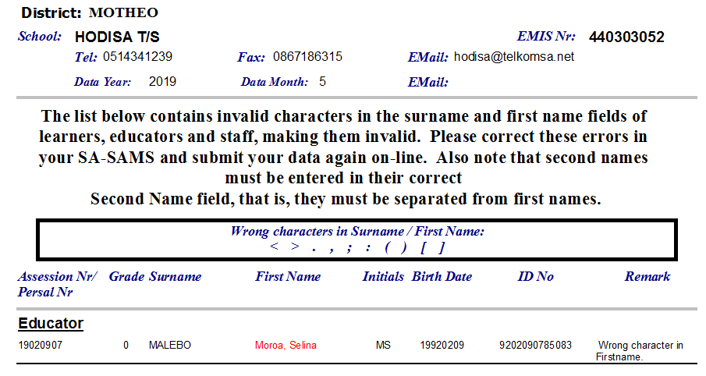

Slide 11
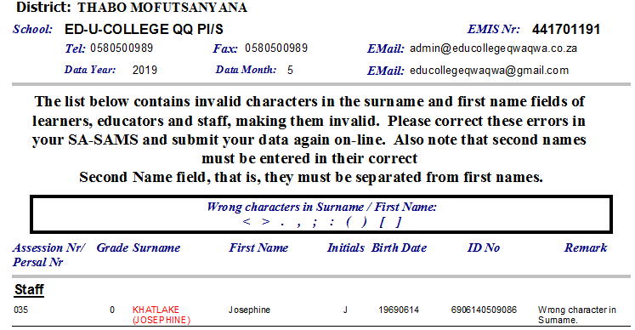

Slide 12
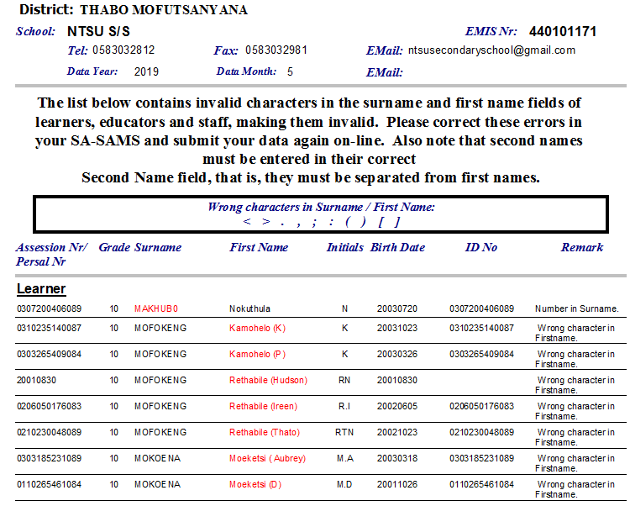

Slide 13
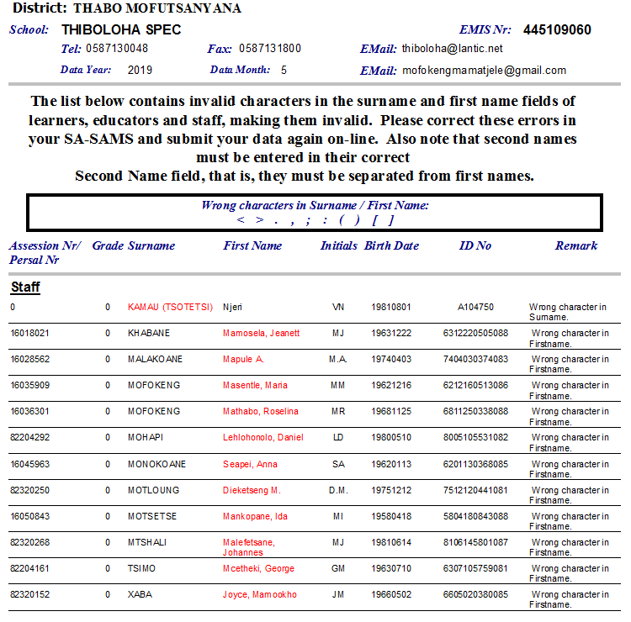

Slide 14
School without a Principal
Latest Import All Years
Computer | Principal | District5 | SchoolName | ImportMonth
443907219 |  | DC17 | MATELENA PF/S | 5
440602043 |  | DC17 | NTHABELENG P/S | 5
440304248 |  | DC17 | OLYMPIA P/S | 5
442607187 |  | DC17 | PETRUSHOOP PF/S | 5
440602039 |  | DC17 | QELO S/S | 5
440602051 |  | DC17 | RAOHANG I/S | 5
440303145 |  | DC17 | SONSKYN PF/S | 5
443907259 |  | DC17 | TONYA P/S | 5
445802181 |  | DC17 | VISTA JUNIOR ACADEMY PI/S | 5
440303165 |  | DC17 | WILLOWS PF/S | 5
440808296 |  | DC18 | BULTFONTEIN C/S | 5
444908303 |  | DC18 | NELSDRIF P/S | 5
444712085 |  | DC18 | ST DOMINIC'S COLLEGE CI/S | 5
444306201 |  | DC18 | TIDOR PF/S | 5
440704235 |  | DC18 | VERKEERDEVLEI P/S | 5
445802186 |  | DC18 | VIRGINIA S/S | 5

Slide 15
Latest Import All Years
Computer | Principal | District5 | SchoolName | ImportMonth | DCNAME
443410332 |  | DC19 | BEYERSGIFT PF/S | 5 | THABO MOFUTSANYANA
445802128 |  | DC19 | EBENEZER CHRISTIAN ACADEMY PI/S | 5 | THABO MOFUTSANYANA
441705211 |  | DC19 | HARRISMITH CHRISTIAN ACADEMY CI/S | 5 | THABO MOFUTSANYANA
442710359 |  | DC19 | KWETLISONG S/S | 5 | THABO MOFUTSANYANA
440101154 |  | DC19 | MISPA PF/S | 5 | THABO MOFUTSANYANA
445105171 |  | DC19 | MOHLAKANENG I/S | 5 | THABO MOFUTSANYANA
443701267 |  | DC19 | PAUL ERASMUS S/S | 5 | THABO MOFUTSANYANA
445105175 |  | DC19 | SEDIBENG P/S | 5 | THABO MOFUTSANYANA
441811004 |  | DC20 | DIPKRAAL IF/S | 5 | FEZILE DABI
442506251 |  | DC20 | HAMILTONSRUST PF/S | 5 | FEZILE DABI
444306288 |  | DC20 | LEEUWPAN PF/S | 5 | FEZILE DABI
442506007 |  | DC20 | PLATBERG PF/S | 5 | FEZILE DABI
443611282 |  | DC20 | SCHOOL OF DESTINY CI/S | 5 | FEZILE DABI
443701216 |  | DC20 | SUSANNA PF/S | 5 | FEZILE DABI

Slide 16
vw_LatestImportAllYears
Computer | Cell | Tel_Code: | Tel_No: | Fax_Code | Fax_No: | District5 | SchoolName | ImportMonth | DCNAME
445802163 |  |  |  |  |  | DC18 | ADELAIDE TAMBO S/S | 5 | LEJWELEPUTSWA
441501009 |  |  |  |  |  | DC19 | MAGDALENA PF/S | 5 | THABO MOFUTSANYANA
442506251 |  |  |  |  |  | DC20 | HAMILTONSRUST PF/S | 5 | FEZILE DABI
442701043 |  |  |  |  |  | DC20 | MAKAWAANSBANK PF/S | 5 | FEZILE DABI
441610223 |  |  |  |  |  | DC20 | OPLOOP PF/S | 5 | FEZILE DABI
442701220 |  |  |  |  |  | DC20 | RIETFONTEIN PF/S | 5 | FEZILE DABI
444306150 |  |  |  |  |  | DC20 | KGATELOPELE PF/S | 5 | FEZILE DABI
442506154 |  |  |  |  |  | DC20 | NOORDSKOOL PF/S | 5 | FEZILE DABI
440506265 |  |  |  |  |  | DC20 | KOEBERG PF/S | 5 | FEZILE DABI
441811225 |  |  |  |  |  | DC20 | ONGEGUND PF/S | 5 | FEZILE DABI
442506292 |  |  |  |  |  | DC20 | DOORNSPRUIT PF/S | 5 | FEZILE DABI
444306039 |  |  |  |  |  | DC20 | JONKERSKRAAL PF/S | 5 | FEZILE DABI
441811003 |  |  |  |  |  | DC20 | ROODERAND PF/S | 5 | FEZILE DABI
443410335 |  |  |  | 058 |  | DC19 | SWARTBERG PF/S | 5 | THABO MOFUTSANYANA

Slide 17
2018
Schools with No Promotions
65 Schools

Slide 18
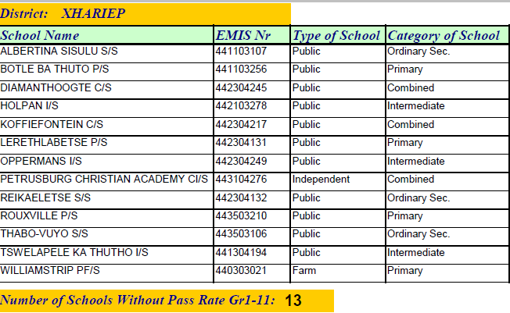

Slide 19
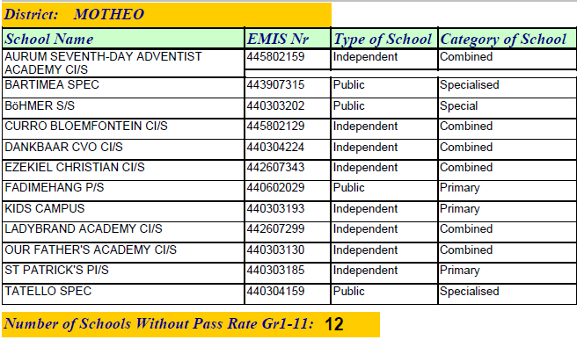

Slide 20
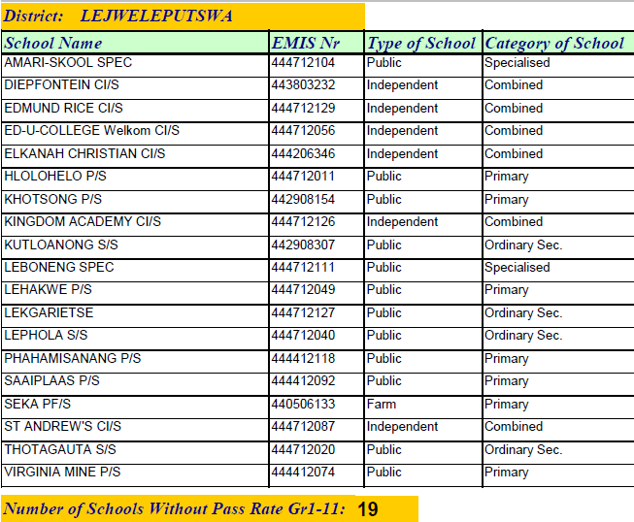

Slide 21
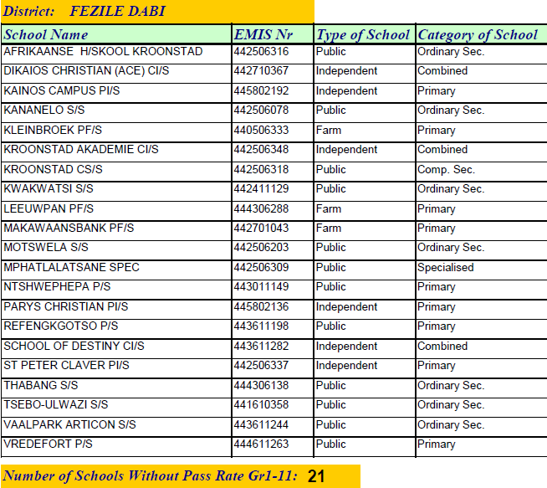

Slide 22

Some schools’ Educator teaching load is not captured

Slide 25
All learner pregnancies are not captured on SA-SAMS

Slide 28
Learner Admissions

Slide 29
Requirements for admissions:
In terms of SECTION 5(4)(a) of SASA CHAPTER 2,
the admission age of a learner to a Public School to:
Grade R is age four turning five by 30 June in the year of admission.
Grade 1 is age five turning six by 30 June in the year of admission.

Slide 30
Documents required for admissions
Schools are to accept an application form conditionally in cases where the parent does not have the stipulated documents.
The principal must advise the parent on where to obtain the necessary information, and the need to provide the school with proof within two weeks that he/she has applied for the necessary documentation so that parents can be assisted if the required documents are not becoming available.
An application accepted conditionally, the parent must ensure that admission of the learner is finalized within 3 months of conditional admission.

Slide 31
An application form submitted by a parent applying for the registration and the admission of his/her child as an entry phase learner to a school must be supported with the following documents:
The original or a copy of the Birth Certificate of the child;
Proof of the parent's identity and citizenship;
Proof of the child's residence or his/her parent's work address;
Where the parent is not the natural parent of the child: documentation supporting the Parents' legal relationship with the learner;
In the case of admission to a primary school: proof that the child has been immunized against polio, measles, tuberculosis, diphtheria, tetanus and hepatitis B;
The most recent school report of the child, if he or she is currently enrolled at another School; and
Proof of sibling relationship if claimed such.

Slide 32
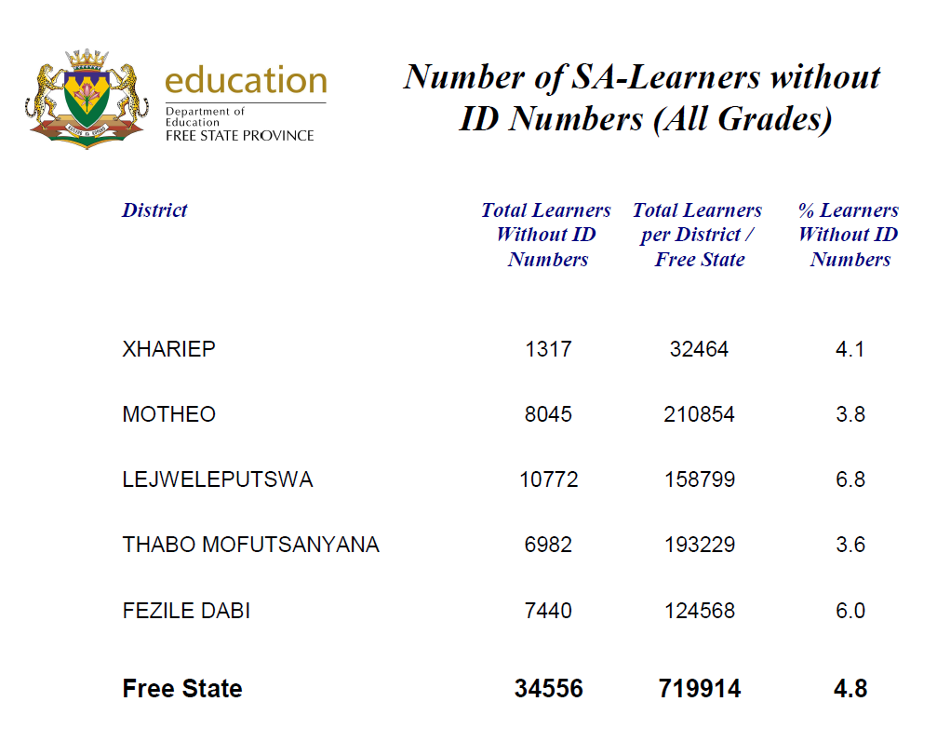

Slide 33
National Population Register (NPR) Learners with ID numbers but not in SA-SAMS

Slide 34
Auditor General
Refers to these documents as source documents
Copies must be kept in each child’s file at school for verification by officials and AG
Source documents for Learner attendance and Teacher Attendance must by kept for AG purposes.
All exam scripts must also be stored for AG purposes

Slide 35
Implementing the Council of Education Ministers (CEM) decision to make learner ID Numbers mandatory on all Computerized School Administration Management Systems:
Learner ID numbers:
The Council of Education Ministers (CEM) approved in November 2012 that learner ID numbers is made mandatory on the Learner Unit Record Information and Tracking System (LURITS),
SA-SAMS and LURITS Accredited Software Systems (LASS).
The mandatory ID number will assist school principals to enforce the relevant section of the admission policy whereby the parent must present an official birth certificate of the learner when admitted to a school.
Section 15 of the Admission Policy in the National Education Policy Act of 1996 states: "When a parent applies for the admission of a learner to an ordinary public school, the parent must present an official birth certificate of the learner to the principal of the public school. If a parent is unable to submit the birth certificate, the learner may be admitted conditionally until a copy of the birth certificate is obtained from the regional office of the Department of Home Affairs.

Slide 36
Schools must capture the learner's name/s, surname and ID number accurately as it appear on the birth certificate/study permit in the school's computerized administration management system:
Only text and no number or special characters (unless it forms part of the official name and surname, e.g. e or 6) is allowed in the name and surname fields.
Examples like Peter/John, Sarah-2006, and Boni. Michael, etc. added to the names or surnames, will be rejected by the computerized systems.
Compliance to the above will ensure that learner data submitted to LURITS is complete and accurate.
Information on learners without birth certificates/study permits must also be captured, indicating that the relevant documentation has been applied for to enable these learners also to be updated to LURITS.
When the birth certificates/study permits are received the learner's data must be updated immediately on the school's computerized system.
All enquiries with regard to the capturing of learner ID number on Computerized School Administration systems must be directed to the EMIS Section at Provincial Head Office.
The responsibility to finalize the conditional admission does not solely lie with the parents of the learner, but also with the Principal of the school that the learner is enrolled in.

Slide 37
Principal's Intervention Steps
Step 1:
Contact the Department of Home Affairs: Provincial Manager's Office alerting them of all learners who need to apply for their Birth Certificates/Study Permits/Identity Documents;
Step 2:
Make arrangements with Home Affairs: Provincial Manager's Office for a mobile centre to visit the school, and request a list of documents required for the applications;
Step 3:
Inform the learners and their parents about the expected visit by Home Affairs, also specifying the list of documents which should be brought along for application;
Step 4:
Coordinate the proceedings on the day of the Home Affairs mobile unit visit, regulate the number of learners to attend the mobile centre class, and arrange seating for parents;
Step 5:
Once Home Affairs delivers the documents, the necessary copies of the documents must be made and filed in the learners' personal files, before the learners can take the documents home.
In the absence of a copy machine, the Surname, Full Names, Date of Birth and ID Number of the learners must be recorded;
Step 6:
The admission status of the learners must be changed from 'conditional admission' to 'admission'.
Ensure that the Surname, Full Names, Date of Birth and ID Number are accurately captured in the school's computerized administration system as they appear on the Birth Certificate/Study Permit

Slide 38
Transfer of learners between schools
The parent of a learner who is currently enrolled at a school (including an independent school) can apply for the learner to be transferred to another public school by completing a Transfer Application Form.
The most recent school report of the learner from his/ her existing school must be attached to the Transfer Application Form.
Transfer application forms on SA-SAMS should be used.
Challenge – Marks for end of year.

Slide 39
NO LTSM INFORMATION

Slide 40
Error and Omission report
Teaching Load and Duplicate Learners

Slide 41
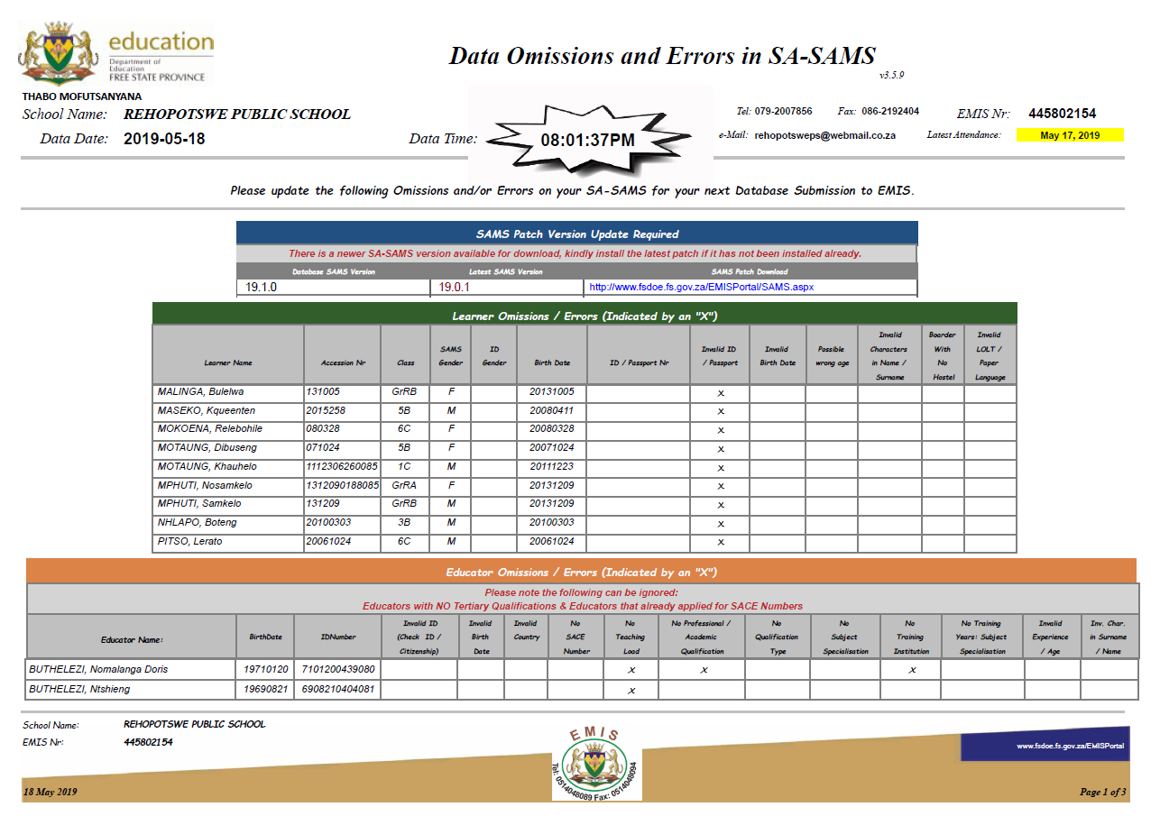

Slide 42
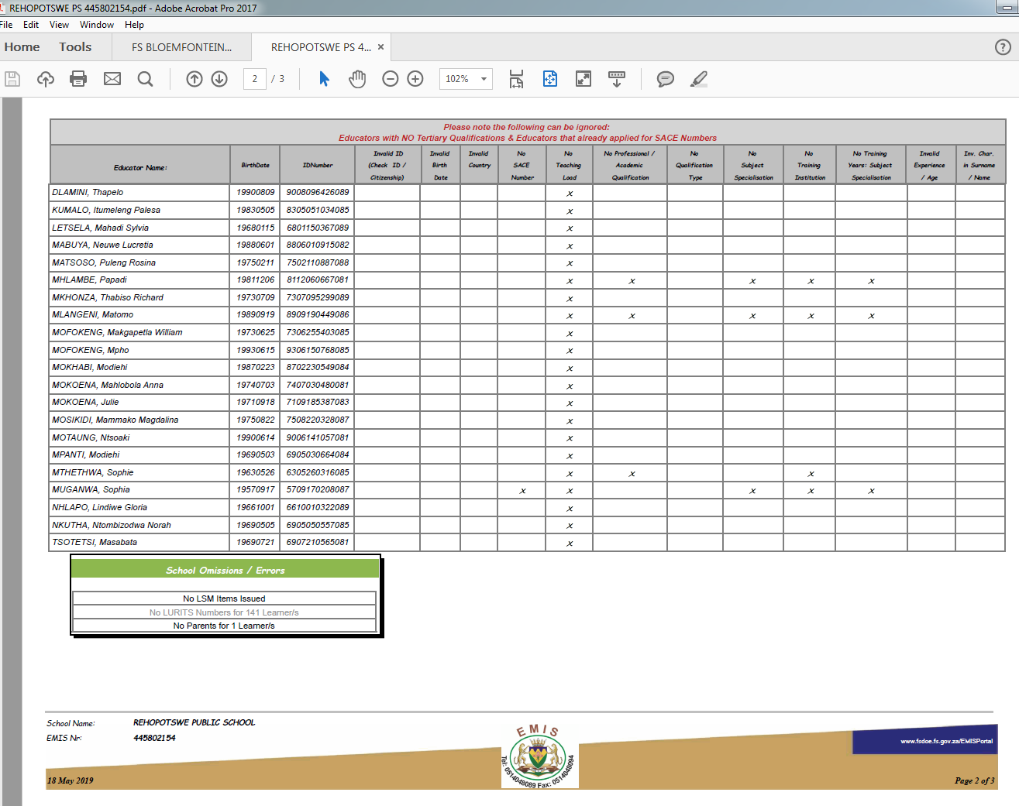

Slide 43
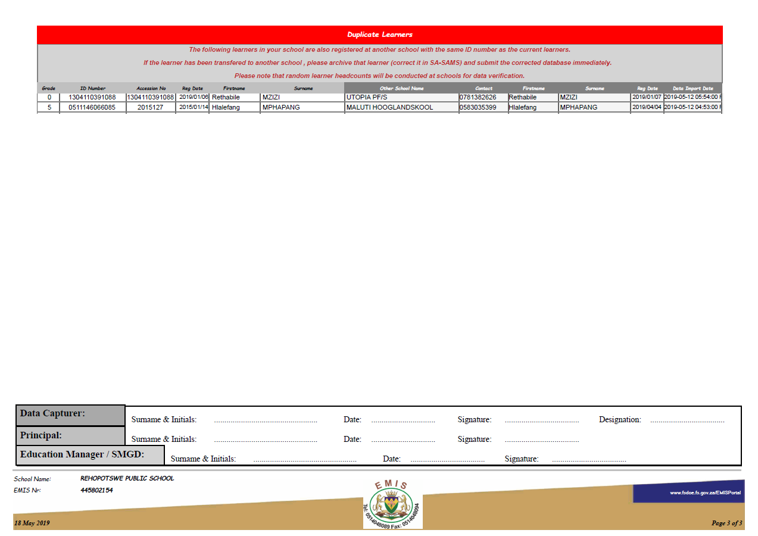

Slide 44
DUPLICATE LEARNERS

Slide 45
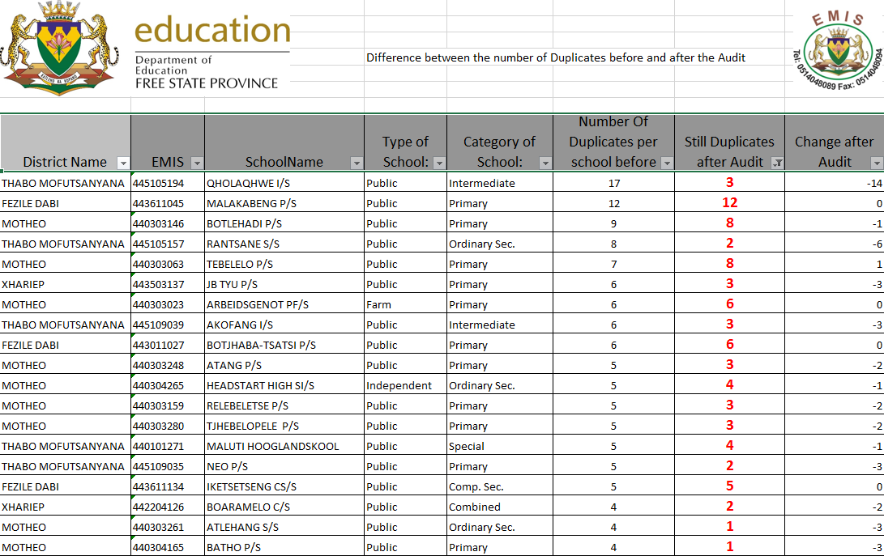

Slide 46
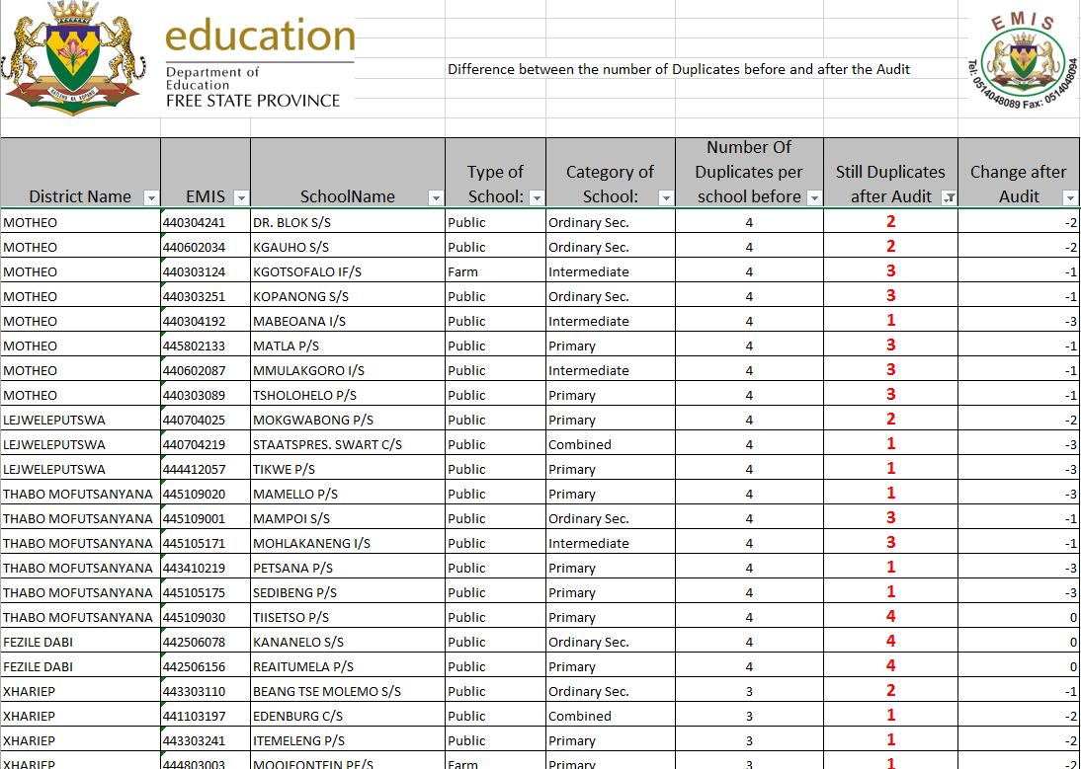

Slide 47
Mismatch subjects
This will also have a negative effect on the delivery of Work Books
Wrong work books will be received
Wrong question papers will be delivered for common papers

Slide 48
Engineering Graphics and Design (EGD) not taken with Technical subjects as stipulated in the Policy

Slide 49
Old Technical Subjects still registered at schools

Slide 50
Learners without any Maths

Slide 51
Learners with less than the stipulated number of subjects

Slide 52
Maths Lit and Technical Maths taken with Physical Science

Slide 53
Learner Ages - Incorrect

Slide 54
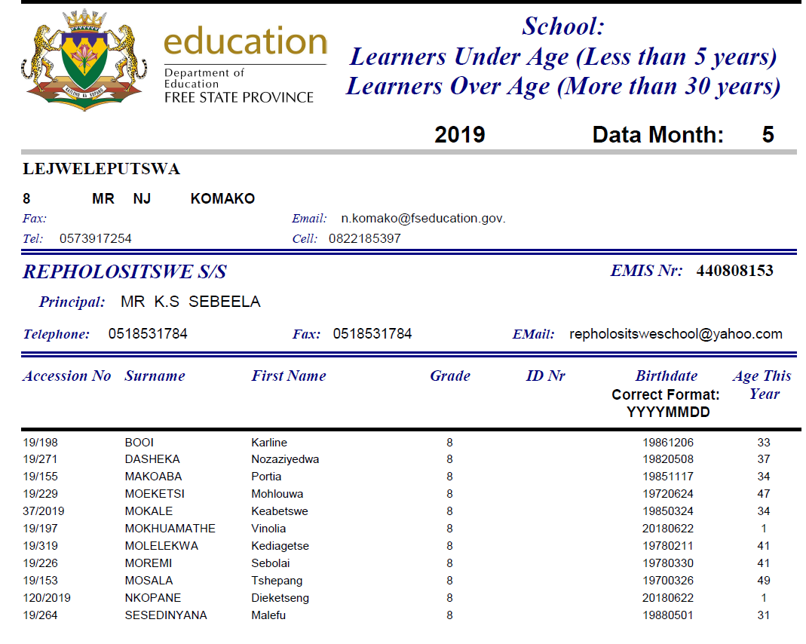

Slide 55
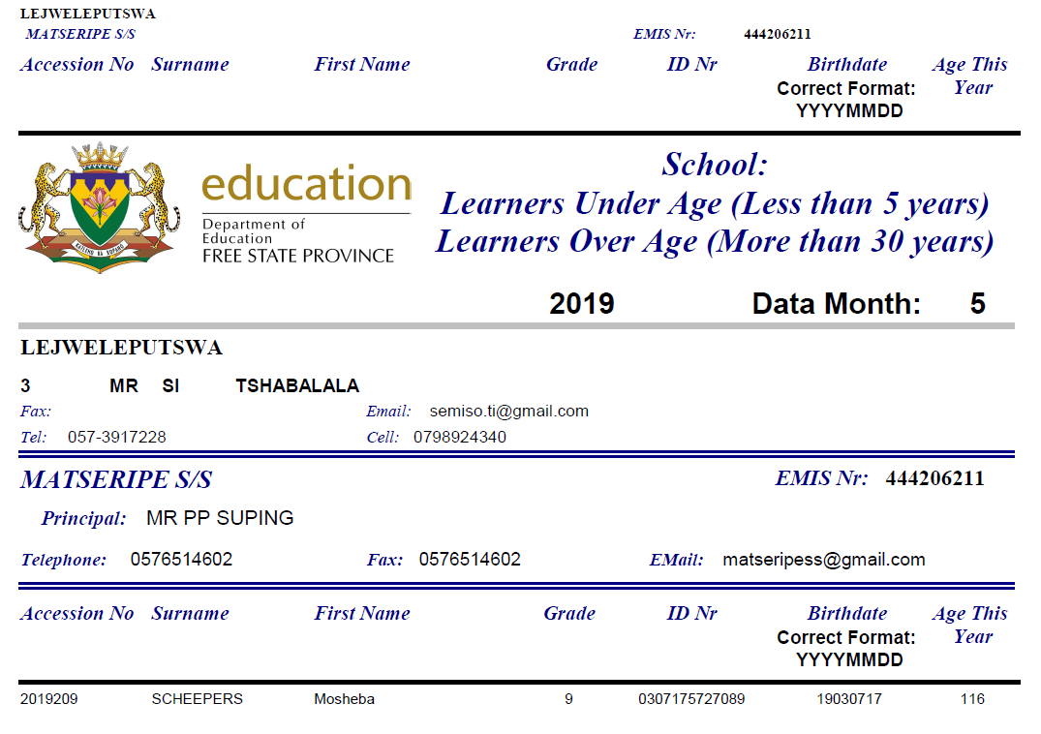

Slide 56
SOME SCHOOLS (Including LSEN) DO NOT REPORT MARKS FOR LEARNERS

Slide 57
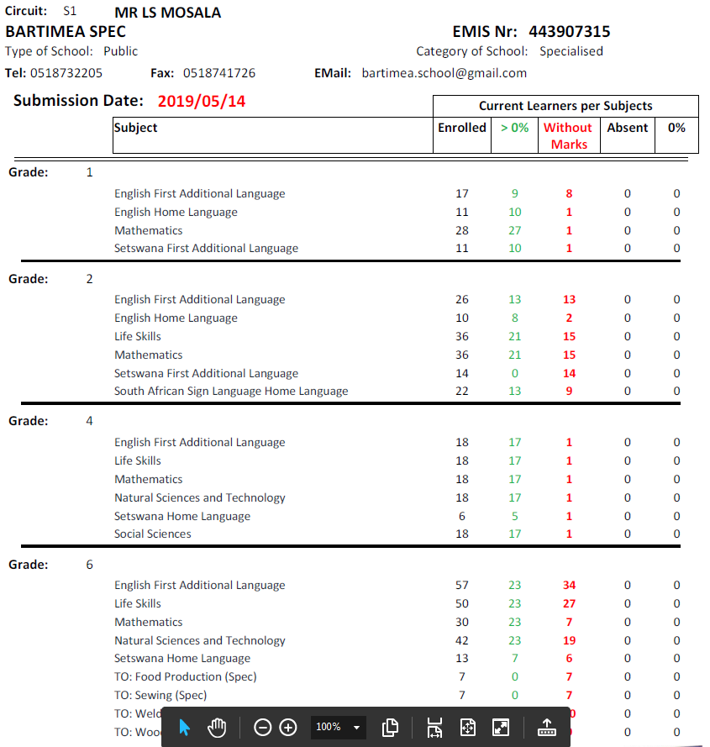
LSEN LEARNERS NOT RESULTED

Slide 58
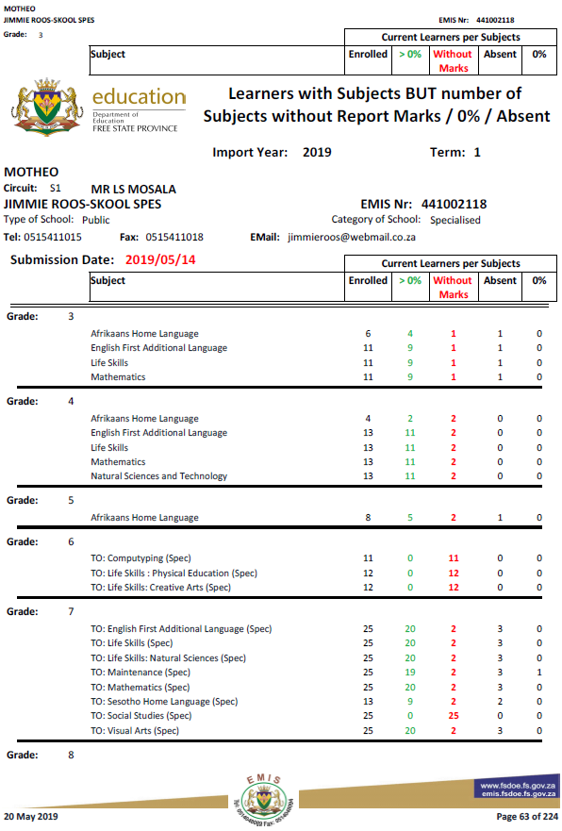

Slide 59
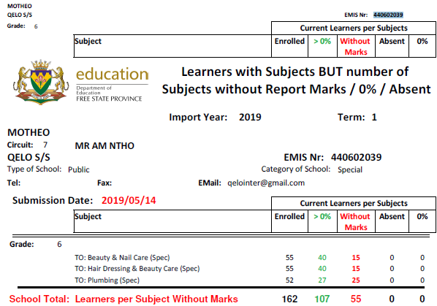

Slide 60
Progressed Learners

Slide 61
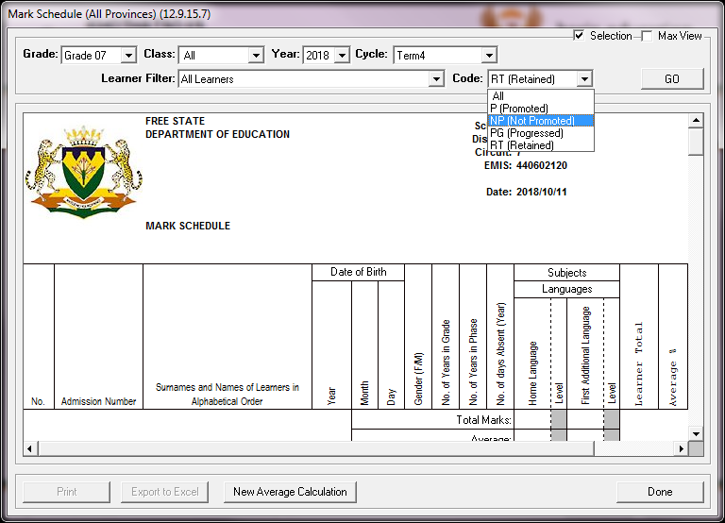
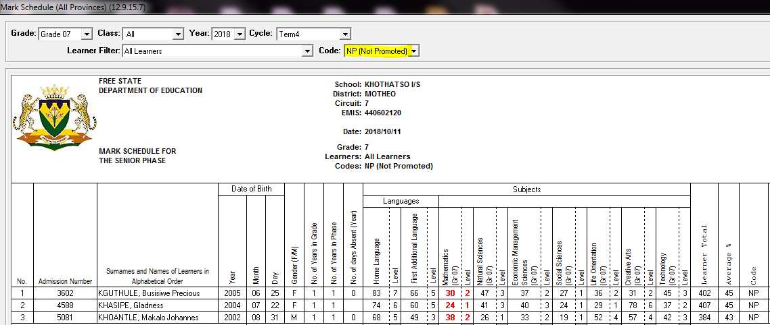
Click on the Print button to print the schedule for the Circuit Manager.

Slide 62
Step 4: Apply a mark adjustment of 2% in a maximum of any three (3) subjects. Under no circumstances should learner marks be adjusted in SA-SAMS because it would then not be possible to trace the progressed learners.
Step 5: After the marks have been adjusted on the printed schedule (12.9.15.7) that shows only learners who obtained NP, the school should go back to 12.7.18(Promotion Schedule) to change NP to P and put in a Deviation Comment.
Select Grade, Class, Year and Cycle. Click on the Go button.
Select a “P” where a learner was “NP” and select a Deviation Comment. The following Deviation Comments are listed on the selection, choose one that applies to the specific learner:
  Learner passed after adjusting the marks in 3 subjects (Math and HL and FAL)(E1 OF 2018).
  Learner passed after adjusting the marks in 2 subjects (Math and HL and FAL)(E1 OF 2018).
  Learner passed after adjusting the marks in 1 subject (Math and HL and FAL)(E1 OF 2018).
  Learner passed after adjusting the marks in 3 subjects (Core and/or other subjects)(E1 OF 2018).
  Learner passed after adjusting the marks in 2 subjects (Core and/or other subjects)(E1 OF 2018).
  Learner passed after adjusting the marks in 1 subject (Core and/or other subject)(E1 OF 2018).

Slide 63
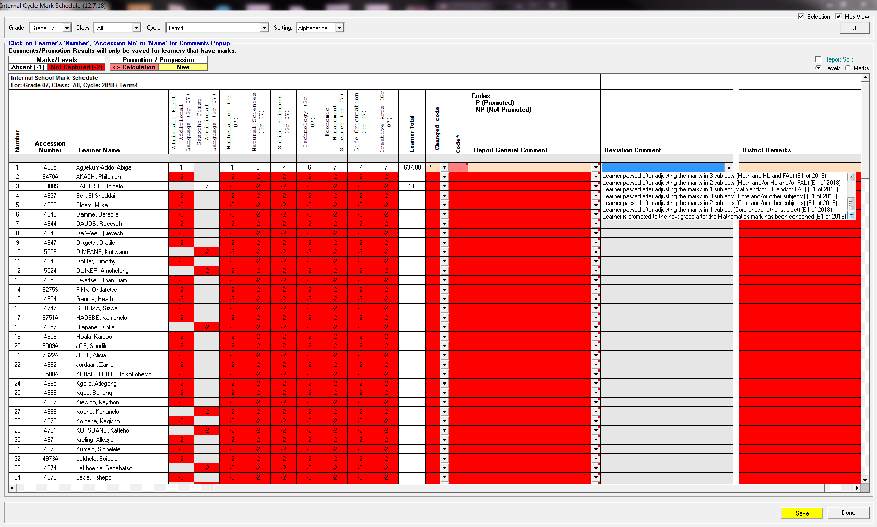
The background colour of the code column will be shaded in pink to show that it was changed from NP to P.
Click on the Save button to save the decision. If it is not saved, it will not display on the Department Mark Schedule.
Step 6: The condonation in Mathematics must be applied after the 2% mark adjustment, where a learner has met all the requirements in respect of promotion from one grade to the next grade, except has not attained a level 3 (40%) in Mathematics and therefore has to be retained, such a learner must be condoned in Mathematics. This implies that the Mathematics mark is condoned and the learner must be promoted to the next grade, if all other pass requirements are met.
Step 7: After the marks of Mathematics have been adjusted on the printed schedule (12.9.15.7) that shows only learners who obtained NP, the school should go back to 12.7.18(Promotion Schedule) to change NP to P and put in a Deviation Comment.
Select Grade, Class, Year and Cycle. Click on the Go button.
Select a “P” where a learner was “NP” and select a Deviation Comment as “Learner is promoted to the next grade after the Mathematics mark has been condoned (E1 of 2018)” on SA-SAMS.

Slide 64
LEARNER MARKS
The way we are reporting on marks
  O = a number
  Open space = NO INFO
  -1 absent
-2 on SA-SAMS = open space by default
Absent learners with reason -1
Marks for a specific activity = 0 -100

Slide 65
SUBMISSION OF DATA

Slide 66


The FREE STATE GOVERNMENT is allocated a 26 MB line for all the officials
Unfortunately this line is very busy during daytime from 07:30 – 16:00
It is for this reason the EMIS Sub-directorate is keeping the submission line open until every Sunday afternoon at 12:00
Peak hours for submissions is from Friday 10:00 – Friday 13:00
Unfortunately all schools want to submit during this time but it is not possible.
Special permission were obtained from DBE to write out old data (keep 5 years of data on SA-SAMS)
1) EMIS with the help of District EMIS and IT staff are busy writing out all data before 2014. Schools should backup and safely store this backup data before this can happen. The databases of schools are then “shrinked” and on average the file sizes are 50% of the original size after shrinking. Once the majority of schools are done the file flow into the receiving server will dramatically change.
2) Majority of schools do have laptops – You only need a laptop with internet connectivity + Exported Database (with Password) + LURITS Deployment form and the Errors Omission and Submission Tool to upload the data to Bloemfontein. This could be successfully done till 12:00 Sunday afternoon. (Preferred not Sundays)

Slide 67
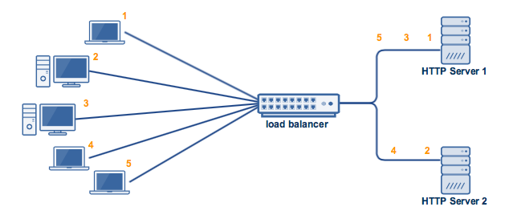
2) Special permission were also requested from IT to host another server for this purpose.
3) Schools are already informed about the Modernisation of SA-SAMS (More or less 2 years)

Slide 68
COMPULSORY SUBMISSION OF EXAM RESULTS TO DISTRICT OFFICE – DG INSTRUCTION - DBE Circular EMIS 1/2019
Information must be submitted to Exams Office in the District Office -
Starting end of second term.

Slide 69
POST PROVISIONING

Slide 70
Post Provisioning over the last few years:
Post Provisioning
Next Year | Learners | Growth in Learner numbers | Average L:E ratio | Posts forfeited to learner growth | Posts | Ratio Learners Per Post
2015 | 621689 |  | 40 |  | 20420 | 30.45
2016 | 632525 | 10836 | 40 | 271 | 20460 | 30.92
2017 | 634977 | 2452 | 40 | 61 | 20460 | 31.04
2018 | 647661 | 12684 | 40 | 317 | 20460 | 31.65
2019 | 650271 | Finishing schools excluded 2610 | 40 | 65 | 20460 | 31.78
2020
Totals |  | 28582 |  | 843
There will be a positive and negative impact : Higher learner numbers = more provincial budget. Higher learner numbers = more teachers needed

Slide 71
200 Ad Hoc post are annually assigned to HR
DateCreated | DataYear | DC | Computer | School_Name: | Source | Gr1 | Gr2 | Gr3 | Gr4 | Gr5 | Gr6 | Gr7 | Gr8 | Gr9 | Gr10 | Gr11 | Gr12 | Gr1-12 | PostProvLearners | CurrentYearLearners | LearnerIncrease | Total Duplicate Learners | DiffDuplicate | Class | Diff
2019-4-23 | 2019 | DC16 | 443104215 | AJC JOOSTE C/S | SA-SAMS: April | 40 | 39 | 41 | 55 | 62 | 36 | 35 | 29 | 36 | 42 | 24 | 19 | 458 | 438 | 458 | 20 |  | 20 | 30 | 0
2019-4-23 | 2019 | DC16 | 443104215 | AJC JOOSTE C/S | SA-SAMS: September | 45 | 40 | 42 | 64 | 45 | 21 | 43 | 38 | 35 | 34 | 20 | 11 | 438 | 438 | 458 | 20 |  | 20 | 30 | 0
2019-4-23 | 2019 | DC16 | 443104215 | AJC JOOSTE C/S | x Calculate Difference | -5 | -1 | -1 | -9 | 17 | 15 | -8 | -9 | 1 | 8 | 4 | 8 | 20 | 438 | 458 | 20 |  | 20 | 30 | 0
2019-4-23 | 2019 | DC16 | 441103107 | ALBERTINA SISULU S/S | SA-SAMS: April | 0 | 0 | 0 | 0 | 0 | 0 | 0 | 128 | 109 | 117 | 84 | 74 | 512 | 500 | 512 | 12 | 1 | 11 | 40 | 0
2019-4-23 | 2019 | DC16 | 441103107 | ALBERTINA SISULU S/S | SA-SAMS: September | 0 | 0 | 0 | 0 | 0 | 0 | 0 | 119 | 104 | 83 | 94 | 100 | 500 | 500 | 512 | 12 | 1 | 11 | 40 | 0
2019-4-23 | 2019 | DC16 | 441103107 | ALBERTINA SISULU S/S | x Calculate Difference | 0 | 0 | 0 | 0 | 0 | 0 | 0 | 9 | 5 | 34 | -10 | -26 | 12 | 500 | 512 | 12 | 1 | 11 | 40 | 0
2019-4-23 | 2019 | DC16 | 443303110 | BEANG TSE MOLEMO S/S | SA-SAMS: April | 0 | 0 | 0 | 0 | 0 | 0 | 0 | 86 | 80 | 92 | 43 | 35 | 336 | 337 | 336 | -1 |  | -1 | 40 | -1
2019-4-23 | 2019 | DC16 | 443303110 | BEANG TSE MOLEMO S/S | SA-SAMS: September | 0 | 0 | 0 | 0 | 0 | 0 | 0 | 72 | 85 | 73 | 48 | 59 | 337 | 337 | 336 | -1 |  | -1 | 40 | -1
2019-4-23 | 2019 | DC16 | 443303110 | BEANG TSE MOLEMO S/S | x Calculate Difference | 0 | 0 | 0 | 0 | 0 | 0 | 0 | 14 | -5 | 19 | -5 | -24 | -1 | 337 | 336 | -1 |  | -1 | 40 | -1
2019-4-23 | 2019 | DC16 | 443203219 | BERGMANSHOOGTE I/S | SA-SAMS: April | 66 | 70 | 44 | 43 | 37 | 42 | 34 | 40 | 0 | 0 | 0 | 0 | 376 | 333 | 376 | 43 | 1 | 42 | 45 | 0
2019-4-23 | 2019 | DC16 | 443203219 | BERGMANSHOOGTE I/S | SA-SAMS: September | 66 | 53 | 32 | 46 | 39 | 35 | 39 | 23 | 0 | 0 | 0 | 0 | 333 | 333 | 376 | 43 | 1 | 42 | 45 | 0
2019-4-23 | 2019 | DC16 | 443203219 | BERGMANSHOOGTE I/S | x Calculate Difference | 0 | 17 | 12 | -3 | -2 | 7 | -5 | 17 | 0 | 0 | 0 | 0 | 43 | 333 | 376 | 43 | 1 | 42 | 45 | 0
2019-4-23 | 2019 | DC16 | 442204126 | BOARAMELO C/S | SA-SAMS: April | 66 | 98 | 69 | 76 | 56 | 63 | 72 | 113 | 87 | 52 | 66 | 29 | 847 | 825 | 847 | 22 | 2 | 20 | 30 | 0
2019-4-23 | 2019 | DC16 | 442204126 | BOARAMELO C/S | SA-SAMS: September | 78 | 102 | 59 | 71 | 70 | 64 | 74 | 109 | 48 | 69 | 35 | 46 | 825 | 825 | 847 | 22 | 2 | 20 | 30 | 0
2019-4-23 | 2019 | DC16 | 442204126 | BOARAMELO C/S | x Calculate Difference | -12 | -4 | 10 | 5 | -14 | -1 | -2 | 4 | 39 | -17 | 31 | -17 | 22 | 825 | 847 | 22 | 2 | 20 | 30 | 0
2019-4-23 | 2019 | DC16 | 445203174 | BOKAMOSO/IKAMVA IF/S | SA-SAMS: April | 11 | 16 | 7 | 9 | 9 | 11 | 16 | 11 | 7 | 0 | 0 | 0 | 97 | 83 | 97 | 14 |  | 14 | 45 | 0
2019-4-23 | 2019 | DC16 | 445203174 | BOKAMOSO/IKAMVA IF/S | SA-SAMS: September | 14 | 13 | 5 | 14 | 7 | 10 | 8 | 8 | 4 | 0 | 0 | 0 | 83 | 83 | 97 | 14 |  | 14 | 45 | 0
2019-4-23 | 2019 | DC16 | 445203174 | BOKAMOSO/IKAMVA IF/S | x Calculate Difference | -3 | 3 | 2 | -5 | 2 | 1 | 8 | 3 | 3 | 0 | 0 | 0 | 14 | 83 | 97 | 14 |  | 14 | 45 | 0
2019-4-23 | 2019 | DC16 | 441103256 | BOTLE BA THUTO P/S | SA-SAMS: April | 102 | 121 | 122 | 82 | 109 | 107 | 70 | 0 | 0 | 0 | 0 | 0 | 713 | 750 | 713 | -37 | 3 | -40 | 45 | -1
2019-4-23 | 2019 | DC16 | 441103256 | BOTLE BA THUTO P/S | SA-SAMS: September | 136 | 100 | 116 | 102 | 114 | 59 | 123 | 0 | 0 | 0 | 0 | 0 | 750 | 750 | 713 | -37 | 3 | -40 | 45 | -1
2019-4-23 | 2019 | DC16 | 441103256 | BOTLE BA THUTO P/S | x Calculate Difference | -34 | 21 | 6 | -20 | -5 | 48 | -53 | 0 | 0 | 0 | 0 | 0 | -37 | 750 | 713 | -37 | 3 | -40 | 45 | -1
2019-4-23 | 2019 | DC16 | 442304245 | DIAMANTHOOGTE C/S | SA-SAMS: April | 99 | 98 | 90 | 115 | 125 | 112 | 132 | 105 | 101 | 157 | 121 | 50 | 1305 | 1276 | 1305 | 29 | 5 | 24 | 30 | 0
2019-4-23 | 2019 | DC16 | 442304245 | DIAMANTHOOGTE C/S | SA-SAMS: September | 106 | 96 | 110 | 103 | 129 | 122 | 99 | 114 | 108 | 158 | 81 | 50 | 1276 | 1276 | 1305 | 29 | 5 | 24 | 30 | 0
2019-4-23 | 2019 | DC16 | 442304245 | DIAMANTHOOGTE C/S | x Calculate Difference | -7 | 2 | -20 | 12 | -4 | -10 | 33 | -9 | -7 | -1 | 40 | 0 | 29 | 1276 | 1305 | 29 | 5 | 24 | 30 | 0
2019-4-23 | 2019 | DC16 | 441103197 | EDENBURG C/S | SA-SAMS: April | 34 | 22 | 31 | 36 | 26 | 33 | 33 | 53 | 44 | 42 | 19 | 19 | 392 | 414 | 392 | -22 | 2 | -24 | 30 | -1
2019-4-23 | 2019 | DC16 | 441103197 | EDENBURG C/S | SA-SAMS: September | 30 | 30 | 34 | 30 | 37 | 25 | 47 | 54 | 46 | 37 | 30 | 14 | 414 | 414 | 392 | -22 | 2 | -24 | 30 | -1
2019-4-23 | 2019 | DC16 | 441103197 | EDENBURG C/S | x Calculate Difference | 4 | -8 | -3 | 6 | -11 | 8 | -14 | -1 | -2 | 5 | -11 | 5 | -22 | 414 | 392 | -22 | 2 | -24 | 30 | -1
2019-4-23 | 2019 | DC16 | 441103221 | EDENHOOGTE P/S | SA-SAMS: April | 43 | 44 | 48 | 45 | 28 | 37 | 46 | 0 | 0 | 0 | 0 | 0 | 291 | 315 | 291 | -24 | 3 | -27 | 45 | -1
2019-4-23 | 2019 | DC16 | 441103221 | EDENHOOGTE P/S | SA-SAMS: September | 53 | 53 | 32 | 40 | 48 | 53 | 36 | 0 | 0 | 0 | 0 | 0 | 315 | 315 | 291 | -24 | 3 | -27 | 45 | -1
2019-4-23 | 2019 | DC16 | 441103221 | EDENHOOGTE P/S | x Calculate Difference | -10 | -9 | 16 | 5 | -20 | -16 | 10 | 0 | 0 | 0 | 0 | 0 | -24 | 315 | 291 | -24 | 3 | -27 | 45 | -1
2019-4-23 | 2019 | DC16 | 443303199 | HENDRIK POTGIETER A/S | SA-SAMS: April | 21 | 18 | 15 | 31 | 23 | 20 | 19 | 24 | 27 | 21 | 30 | 25 | 274 | 301 | 274 | -27 | 2 | -29 | 20 | -2
2019-4-23 | 2019 | DC16 | 443303199 | HENDRIK POTGIETER A/S | SA-SAMS: September | 21 | 14 | 26 | 19 | 21 | 27 | 21 | 34 | 23 | 37 | 25 | 33 | 301 | 301 | 274 | -27 | 2 | -29 | 20 | -2
2019-4-23 | 2019 | DC16 | 443303199 | HENDRIK POTGIETER A/S | x Calculate Difference | 0 | 4 | -11 | 12 | 2 | -7 | -2 | -10 | 4 | -16 | 5 | -8 | -27 | 301 | 274 | -27 | 2 | -29 | 20 | -2

Slide 72
CIRCUIT ALLOCATIONS AND DETAILS
According to the Chief Director District Management EMIS cannot make any changes on school allocations in District – it must be signed off by the HOD.

Slide 73
LTSM – No register
Capture and Write-off books

Slide 74
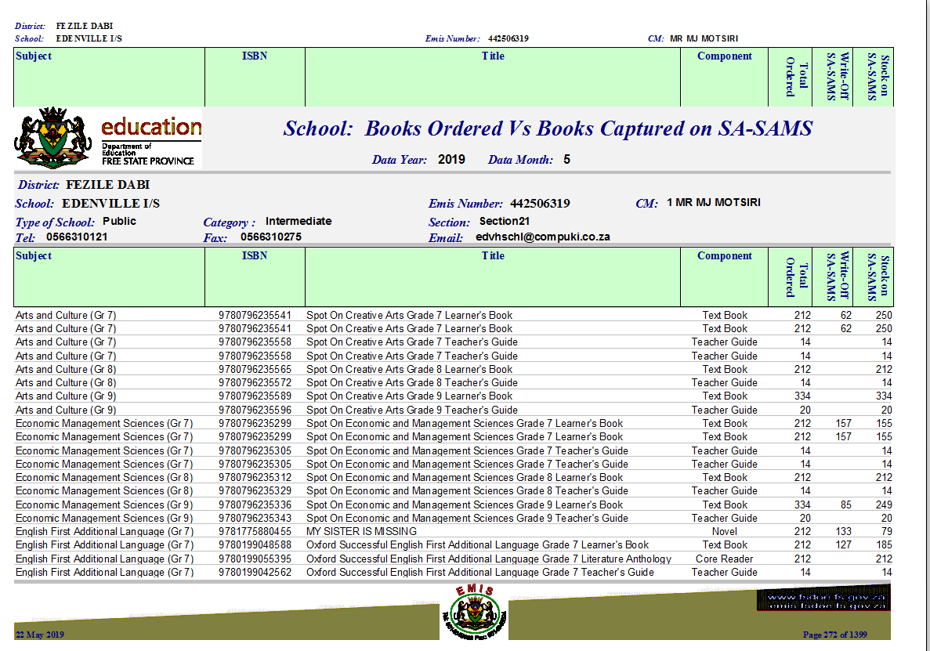

Slide 75
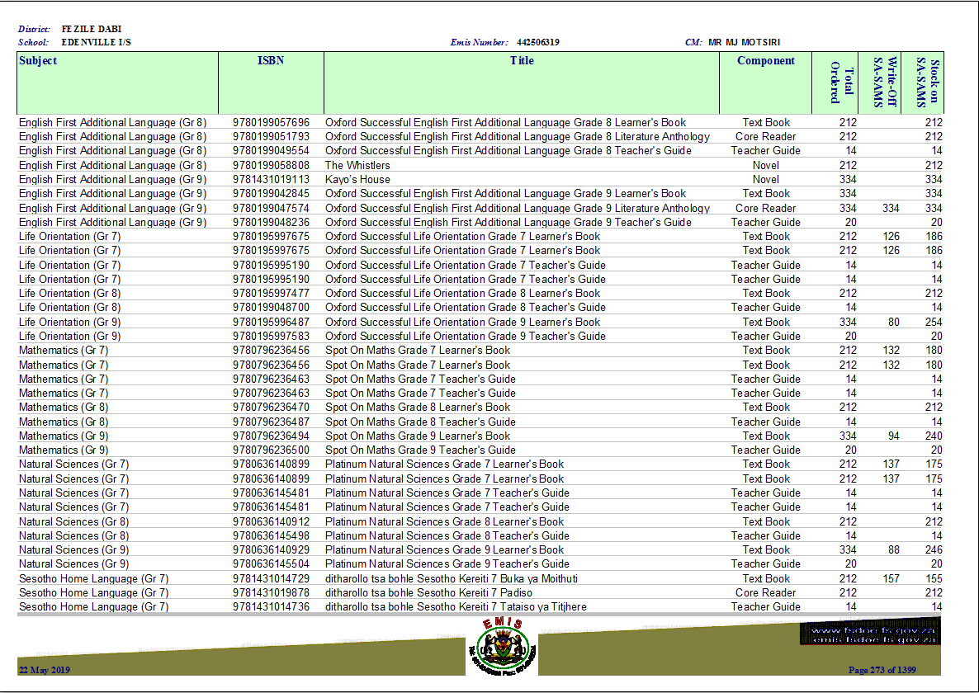

Slide 76
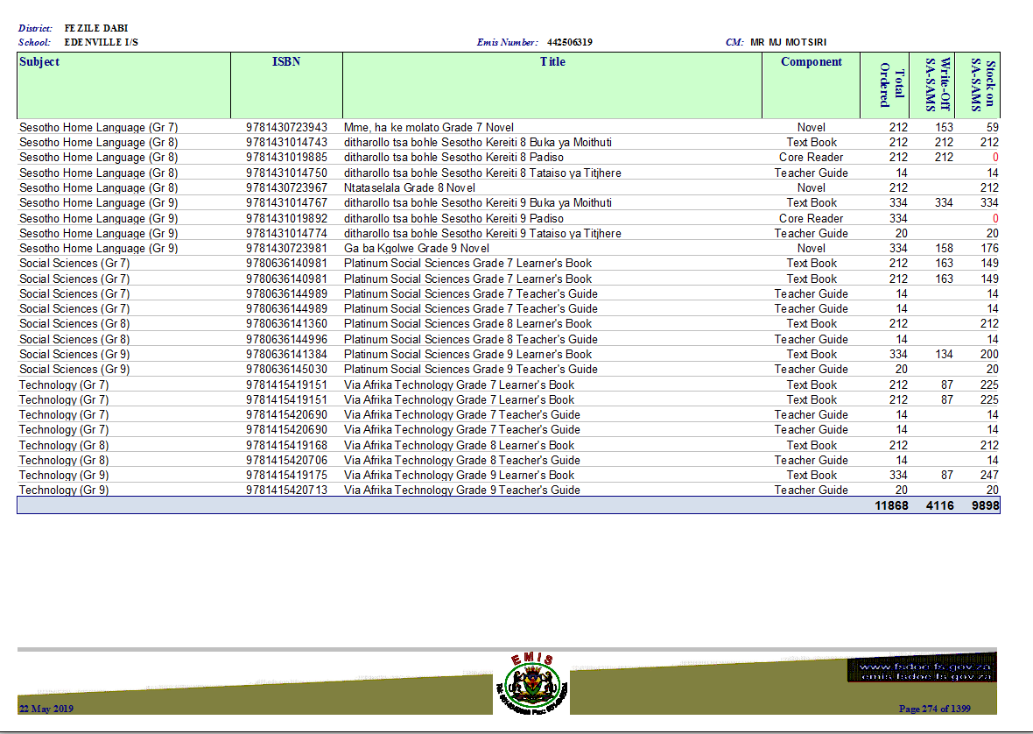

Slide 77
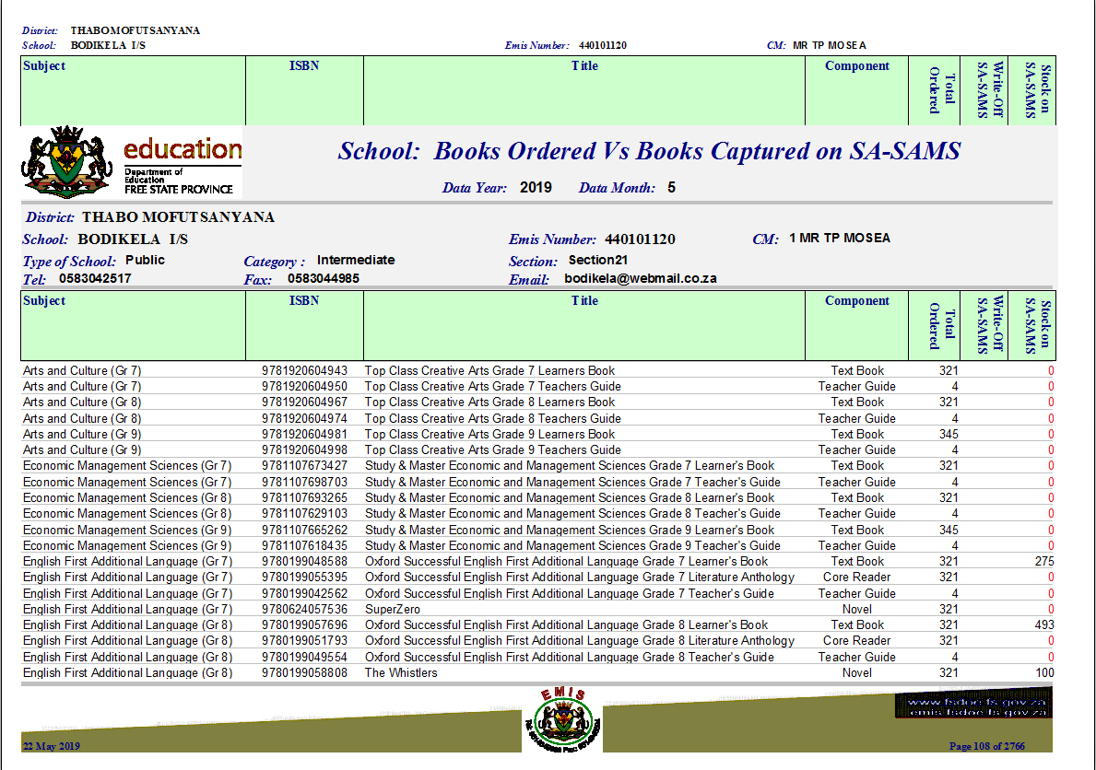

Slide 78
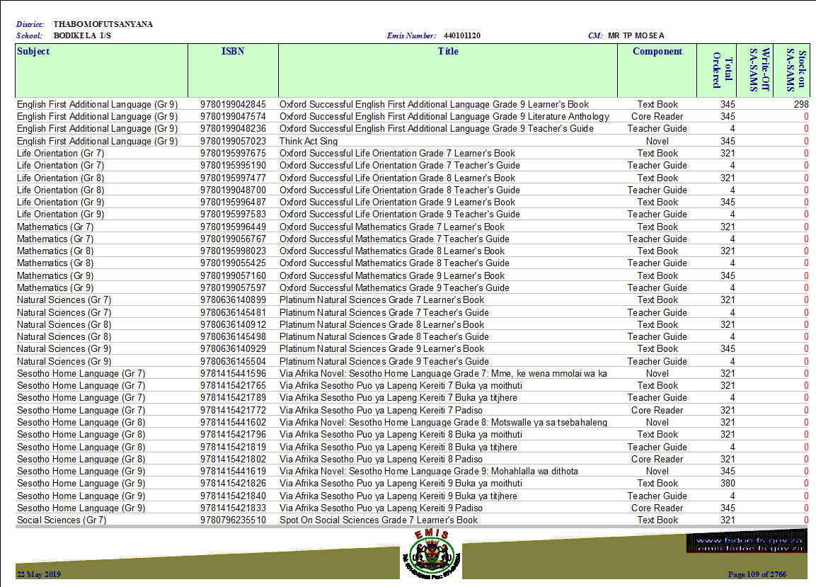

Slide 79
The Way forward
AG
Consequence Management

