Slide 1


SA-SAMS FINANCIAL ASSISTANCE MODULE
Training Version
By : S.P Dithebe

Slide 2
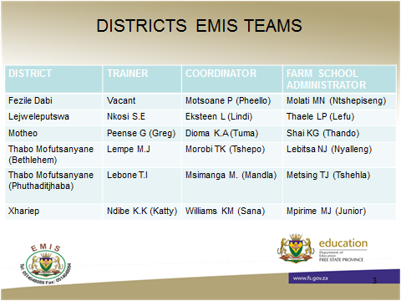

Slide 3
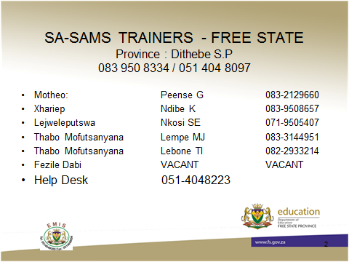

Slide 4
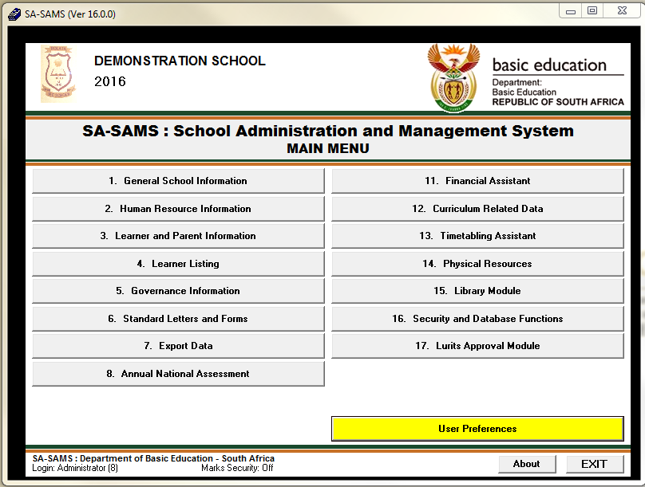

Slide 5
Introduction
The South African School Administration and Management System ( SA-SAMS) was developed to combine all key performance areas / Performance Standards in one pot.
There are several modules used in this system
This computer application is specifically designed to meet the management, administrative and governance needs of all public Schools
It is managed in the Directorate of EMIS (Education Management Information Systems)

Slide 6
Financial Assistance Menu
The Financial Assistant module will help the Finance Administrators to keep proper records of the school.
Enables institutions to maintain and manage their day to day accounting practices and finances accurately
It clearly simplifies the Financial Administrator’s (clerk) and Financial Manager’s (Principal)duties
For this module to be effectively used, the other modules must be completed in full.

Slide 7
COMPONENTS
To prepare the system for the financial year (Setup)
Income
Payments
Cancel transactions
Reprocess transactions
Monthly Bank Reconciliation
Monthly Reports
Annual Reports
Printout and Exports
Closing of Financial year.

Slide 8
Financial Administrator’s work
Take on balance or processed balance
This module needs to be maintained daily.
Prepare the system for the financial year (Setup)
Set up accounting books (Receipt book; Deposit Book, Cheque Book, Petty Cash Book, : Update or first time
Set up budget : First time or annual (Maintain Chart of Accounts, Budget)

Slide 9
Income
Accounts and documentations/proof for money received
Receipt payments to schools
Print a receipt
Deposit Receipt
Direct Payments into bank Account (Enter when bank statement / Deposit slip is received)
Debtors and school fees

Slide 10
Payments
Accounts/ documentation/proof for all payments
Cheque Payments
Direct Payment from bank
Petty Cash Payments
SGB Salary Payments
Manage all requisitions
Cancel unused transactions/documents (Maintain Cheque book, Petty Cash Acc, Deposit Books, Receipt Books)
Cancel receipts/deposits slip/Receipt book.
View Cancelled Cheques (list)
View Audit file

Slide 11
Correction of wrong transactions
Delete the transaction (before bank reconciliation)
Re-Process the deleted transactions (After every deleted transaction)
Journal entry (after bank reconciliation / Incorrect posting of allocation)

Slide 12
Monthly bank reconciliation
Reconcile Bank Statement with the System Transactions
Print Bank Reconciliation per statement
View Reconciled Items & Transactions
View List of Bank Statements on System
View Details of Bank entries
Print Outstanding Cheques
View Cash Book
Print Cash on Hand

Slide 13
Monthly and Annual Financial Statements
Actual Receipt and Payments
Monthly Income Statement
Detailed Year to Date Statement
Annual Statement
View Trial Balance
View Balance Sheet
School Balance Sheet to date
Printout all the documents and file (Triplicate)

Slide 14
Printout and export functions
Transaction printouts
Print Statement of Investment
Total Fees Raised to Debtor Accounts
Export expenditure
Export Budget
Quick Export Functions
View Receipts
View Cheque Payments
View Petty Cash Payments
View Bank & Petty Cash Deposits
View GL Transactions
View Journal Entries

Slide 15
Closing of Financial Year
Year end Functions – Done in January of New Financial Year
Write off debtor Account
Process yearend transactions
New Financial Year
Delete Archived data

Slide 16
Financial Report for The School Managers
This module is designed to assist with school management and contains information that will assist the school, in managing school finances by tracking the budgetary spending monthly.
Tracking budgetary spending (Continuously) is important for the Manager

Slide 17
Monthly and Annual Reports
Monthly and Annual Reports
Bank statements, reconciled statements
Print Outstanding Cheques
Print Cash on Hand
Print Statement of Investment
View Cash Book
View Financial Statement
Actual Receipts & Payments
Monthly Income Statement
Detailed Year to Date Statement
Total Fees Raised to Debtor Accounts
View Trial Balance
View Balance Sheet

Slide 18
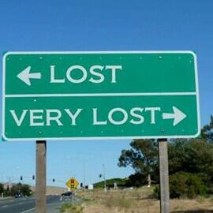

Slide 19
SESSION 2
PRACTICAL DEMONSTRATION OF THE FINANCIAL ASSISTANCE MENU

Slide 21
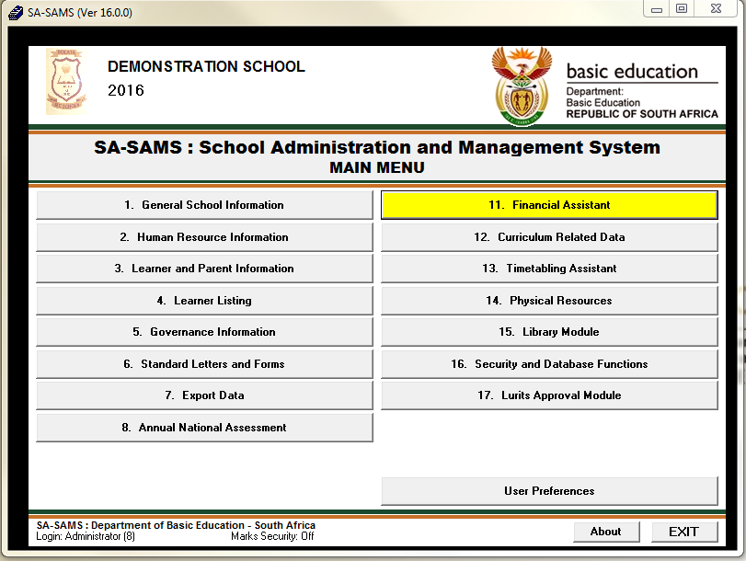

Slide 22
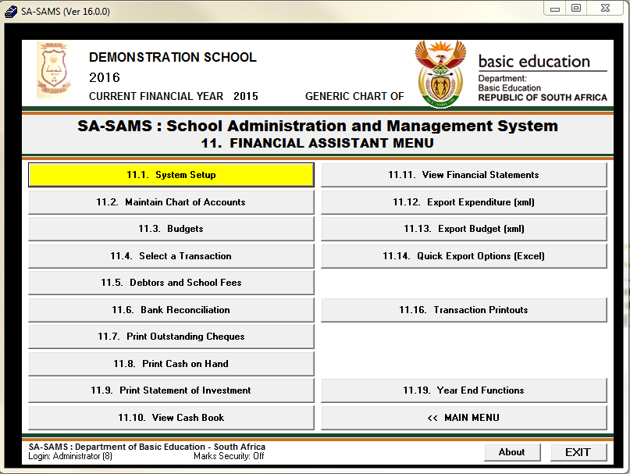
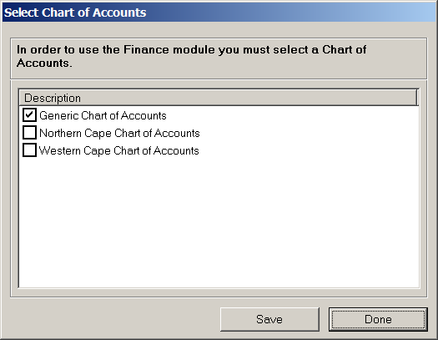

Slide 23
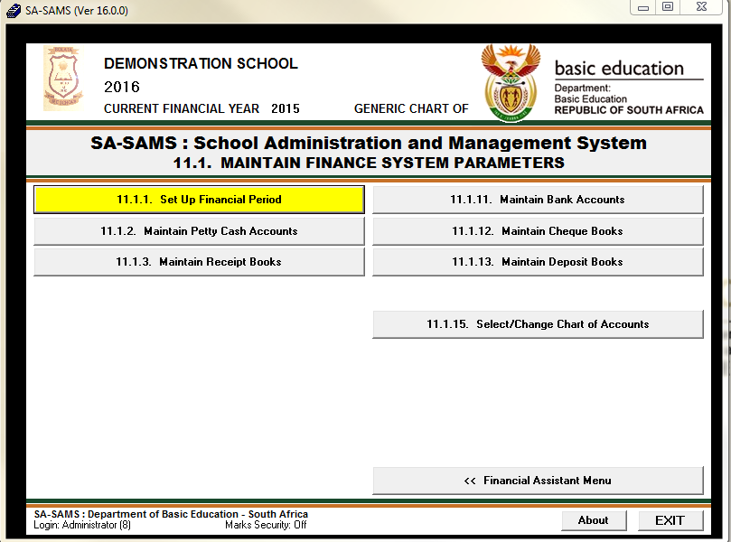

Slide 24
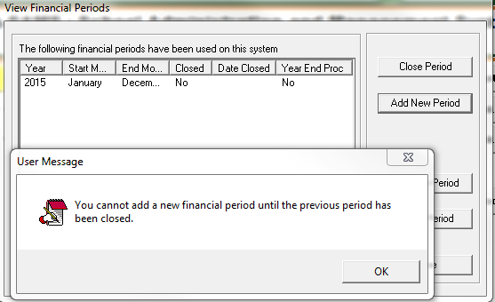

Slide 25
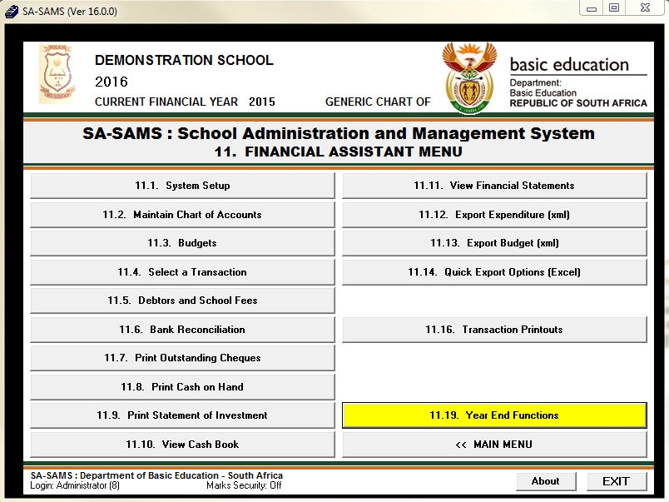

Slide 26
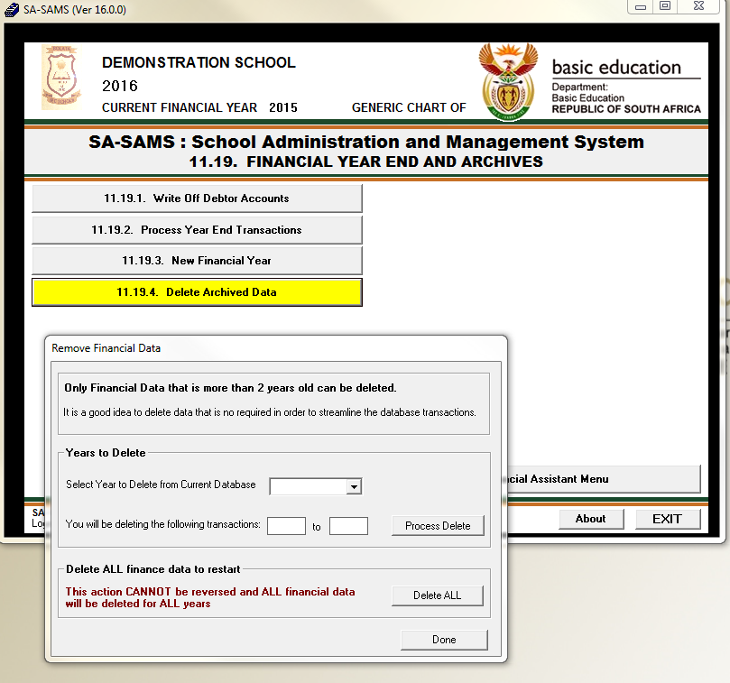

Slide 28
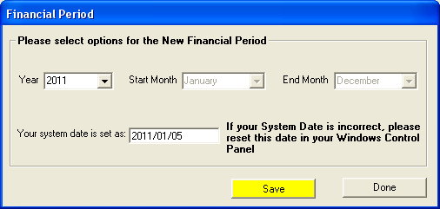
Setup Financial Period and click on Add New Period.

Slide 29
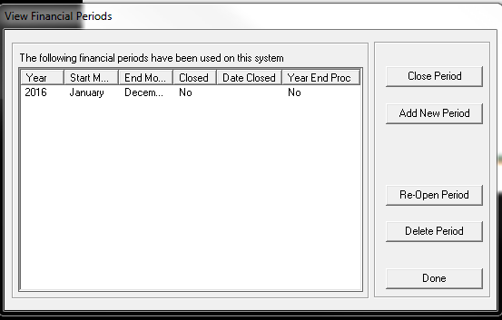
New Financial period

Slide 30
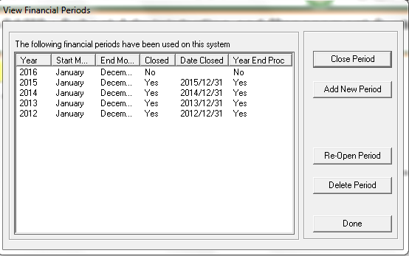
When the financial Period was pre-set

Slide 31
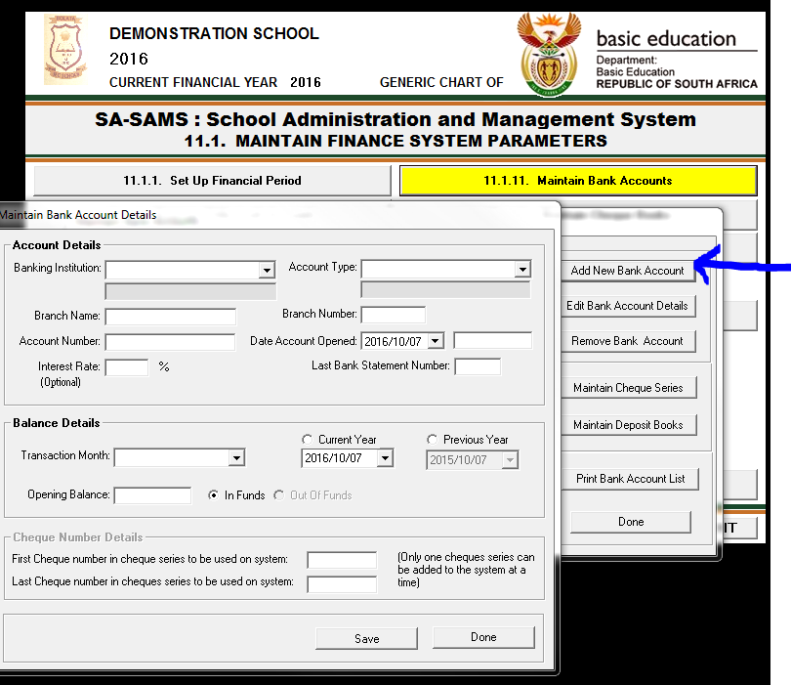

Slide 32
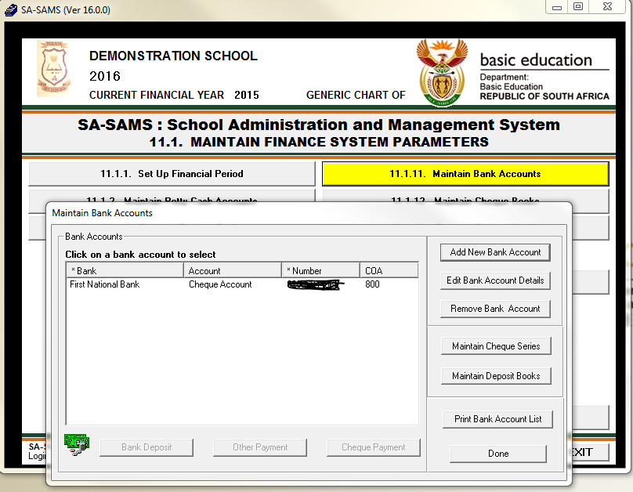

Slide 33
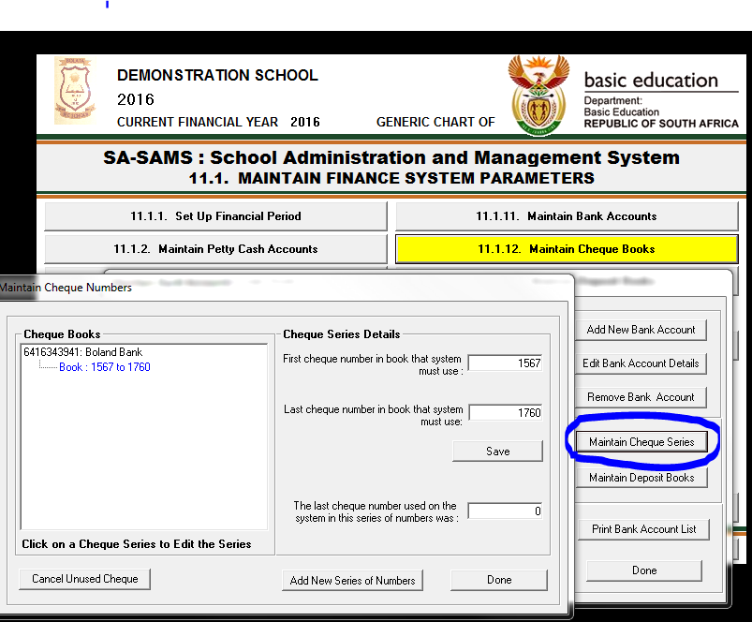

Slide 34
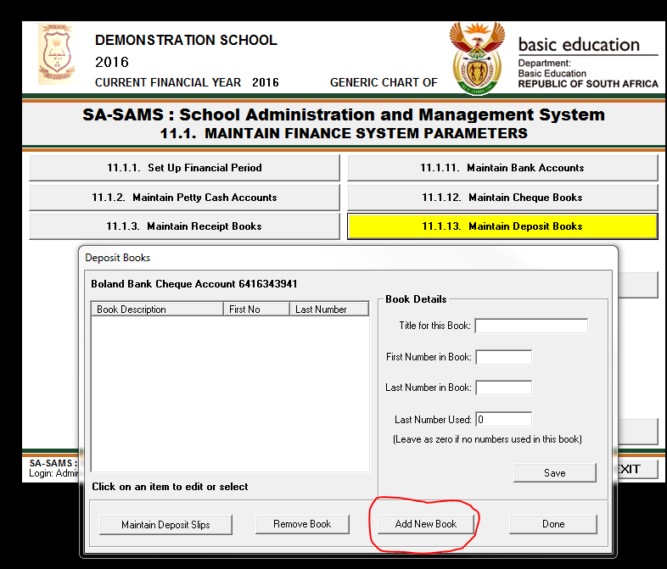

Slide 35
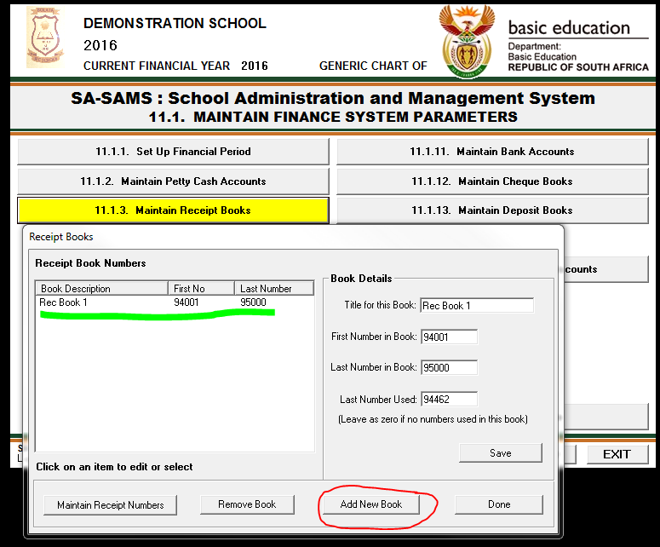

Slide 36
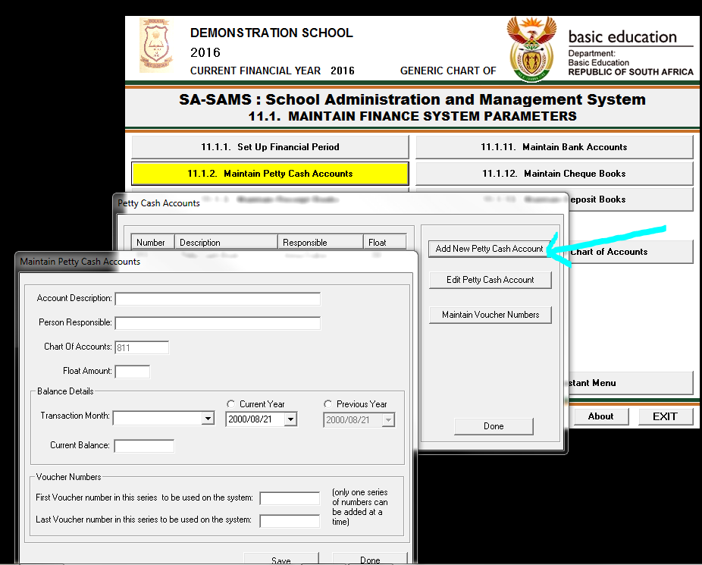

Slide 37
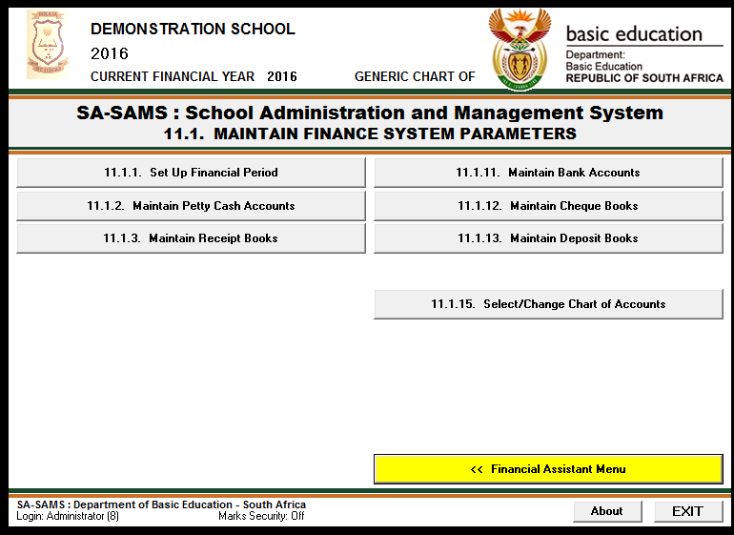

Slide 38
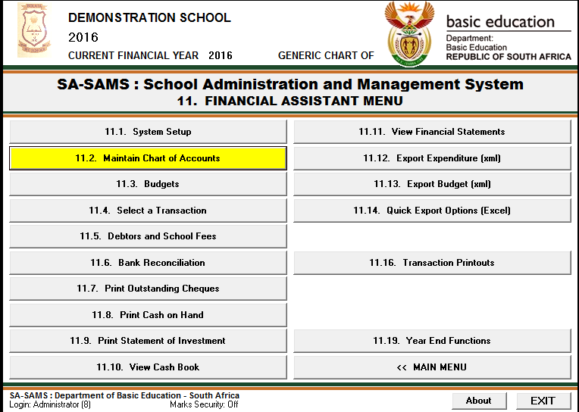
SETTING UP OR MAINTAIN CHART OF ACCOUNTS

Slide 39
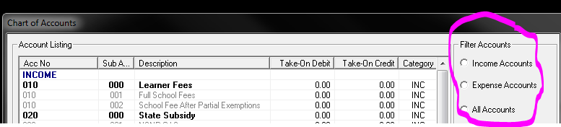
IMPORTANT NOTES WHEN SETTING UP / MAINTAINING CHART OF ACCOUNTS
The accounts under module 11.2 are pre set.
We can not delete them.
We can only add / edit the accounts.
Bold written accounts are called Main Accounts.
Sub Accounts fall under Main Accounts.
The Accounts are filtered as Income Accounts, Expense Accounts or All Accounts.

Slide 40
IMPORTANT NOTES CONTINUED …
When adding a Main Account; select Add New Account.
When adding a sub account; select Add Income / Expense Account.
Edit Account when necessary.
Take On Balances are from previous year.

Slide 41
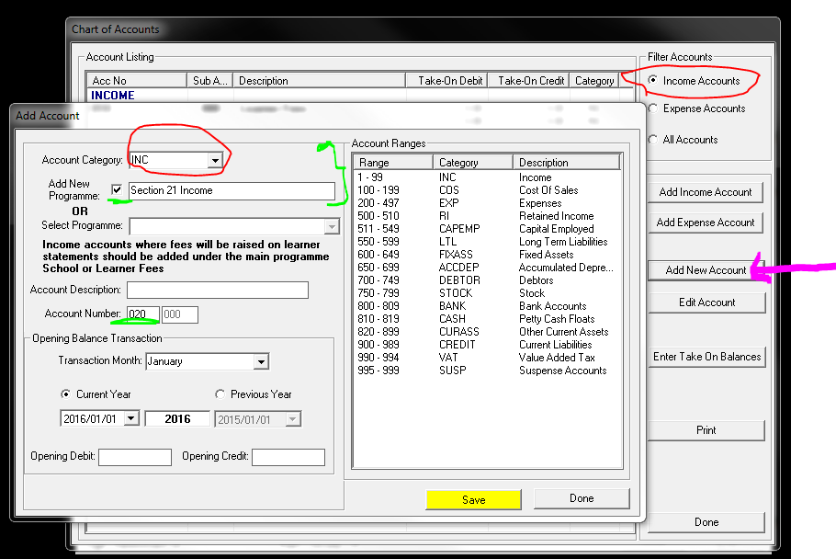
ADD NEW ACCOUNT (Main)

Slide 42
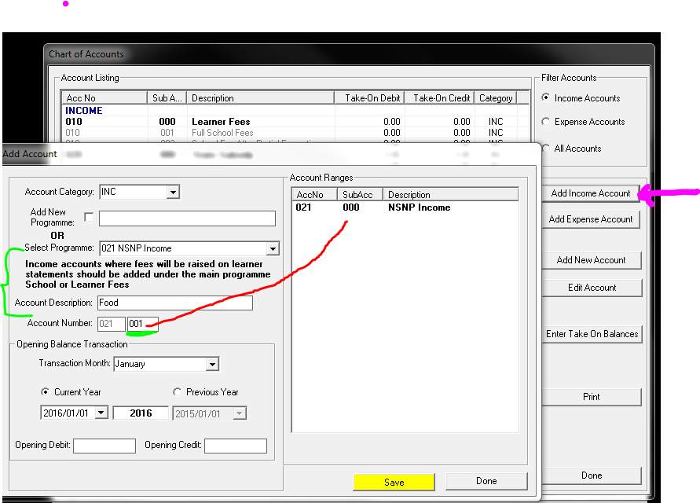
Add Income Account (Sub)

Slide 43
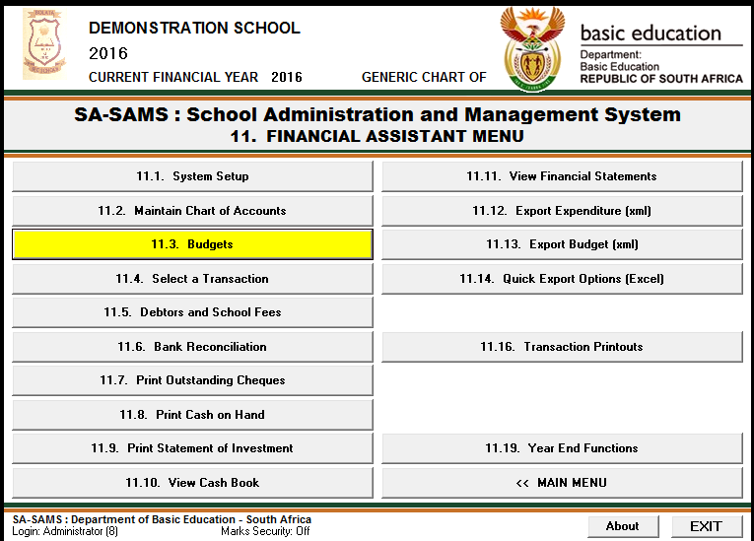
BUDGETS

Slide 44
IMPORTANT NOTES ON BUDGETTING
Please make sure that Chart of Accounts is set as per the school needs.
The current year school budget (SGB Signed) must be used.
Filtering can be made for Current Financial Year or Next Financial Year.
Budget can be set as Annual Budget or Monthly Budget.
Click on Input Budget to enter budgeted amounts.
All Income is the money credited to the school.
All Expenses are debited from the school.

Slide 45
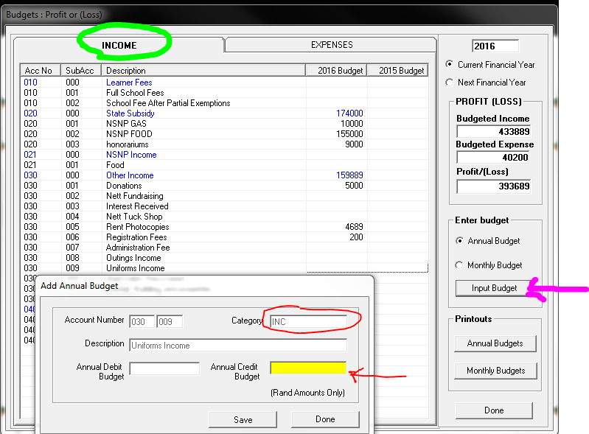
INCOME

Slide 46
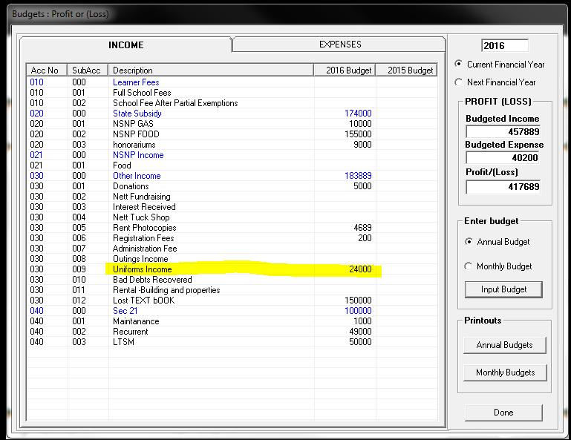

Slide 47
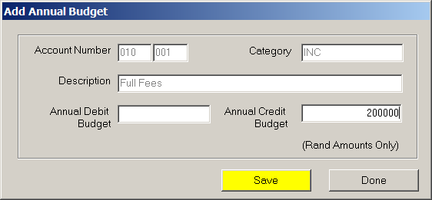
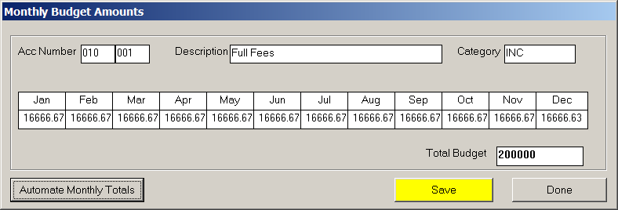
Budget
Can be done annually or monthly
Annual Budget
Monthly Budget

Slide 48
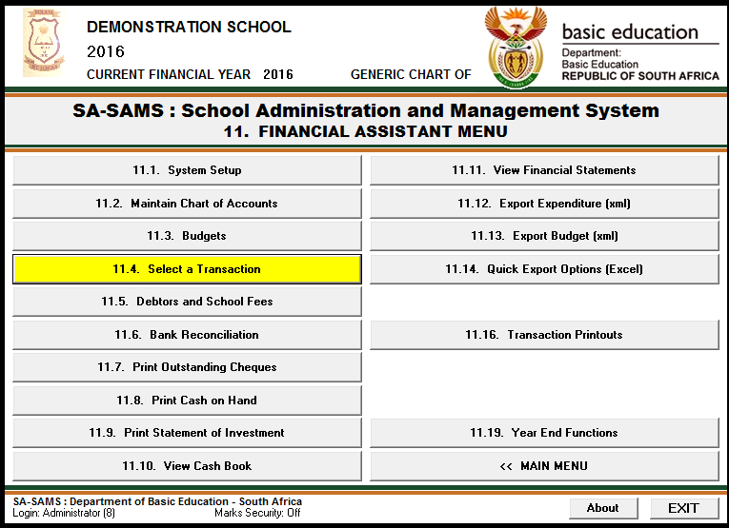
ENTRIES : SELECT A TRANSACTION

Slide 49
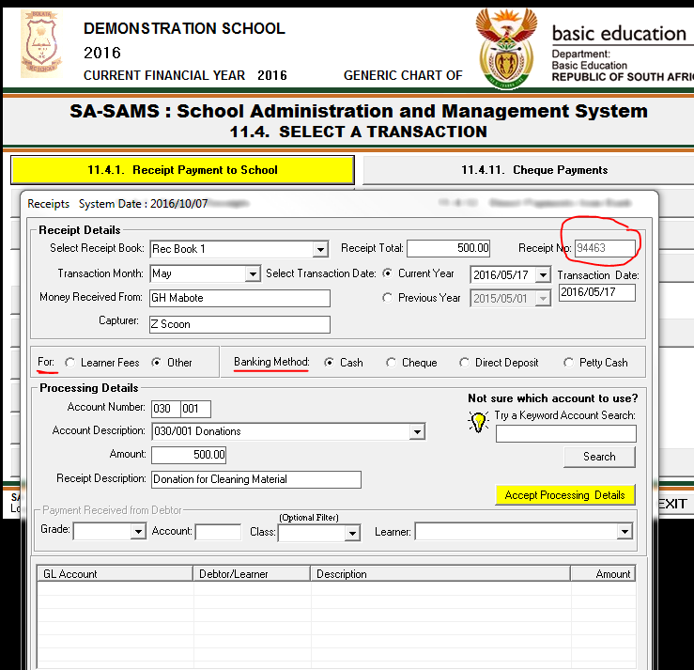
Receipt Payment to School

Slide 50
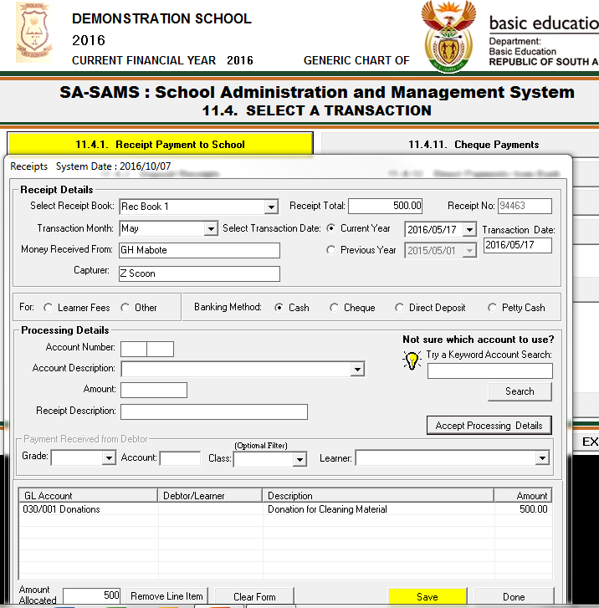

Slide 51
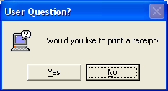
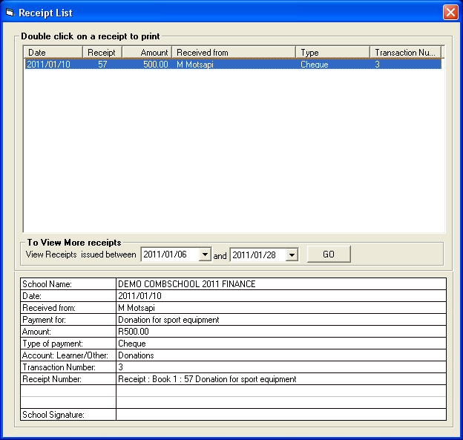
After capturing a receipt, you will be prompted to print a receipt. Double click on receipt to be printed

Slide 52
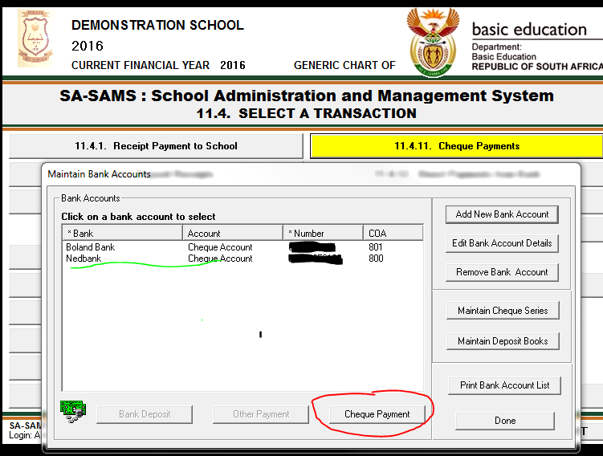
Cheque Payments

Slide 53
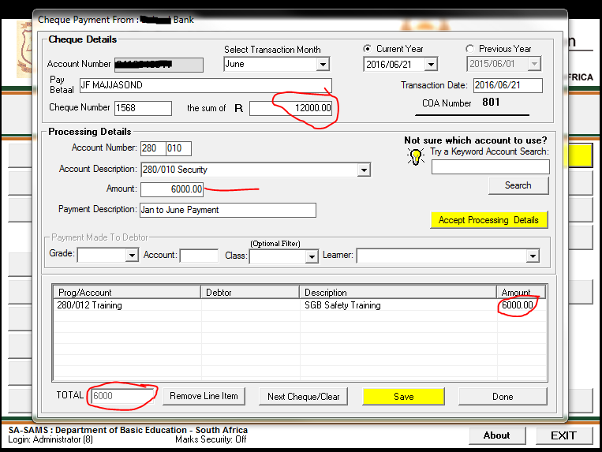
1 Cheque 2 Payments

Slide 54
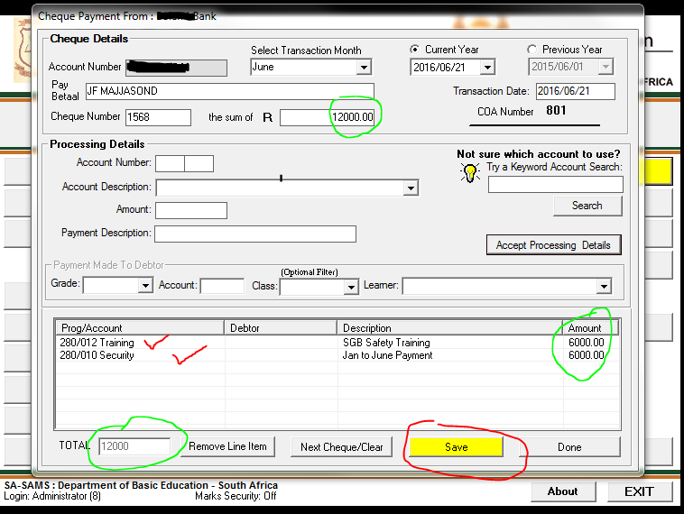
1 Cheque 2 Payments

Slide 55
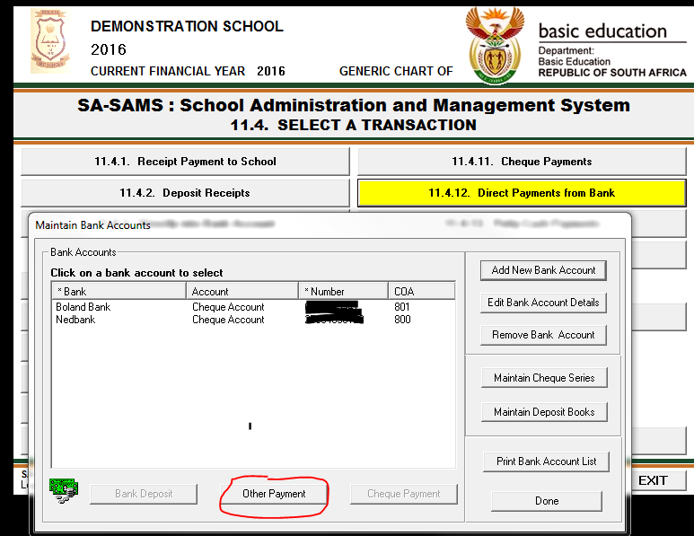
Direct Payments from Bank

Slide 56
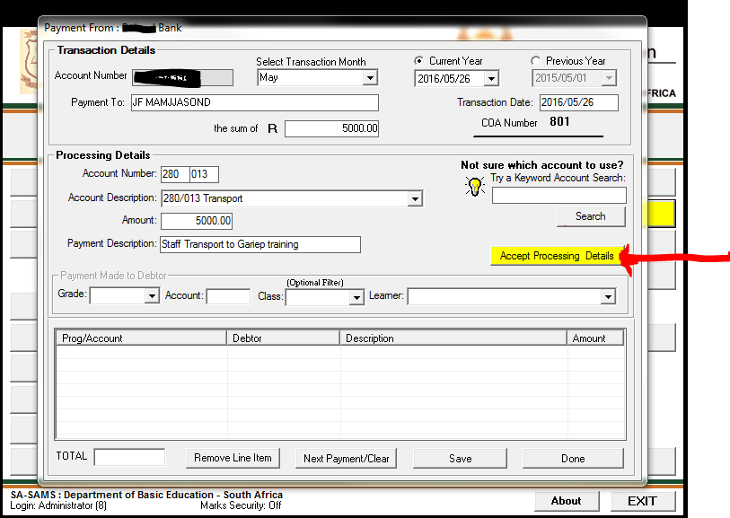
Direct Payment from Bank

Slide 57
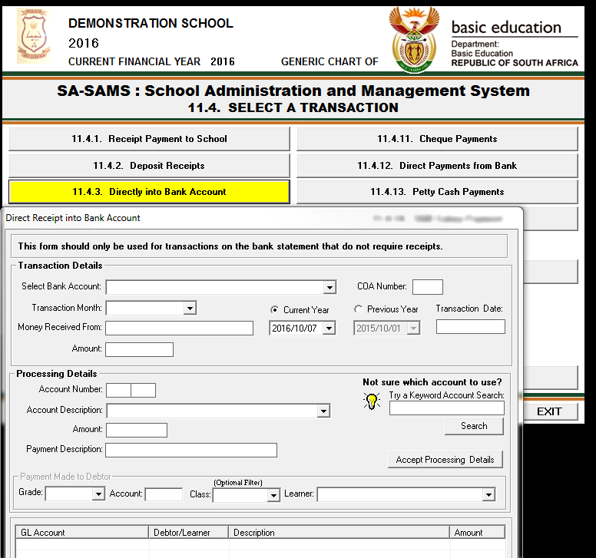
Directly into Bank Account

Slide 58
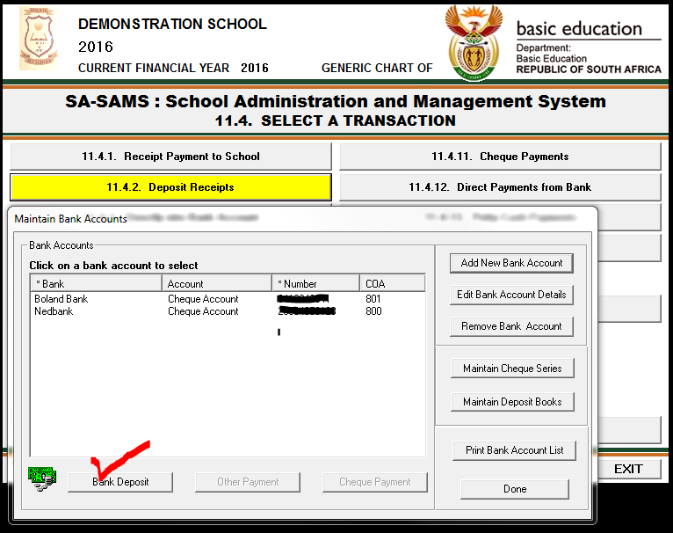
Deposit Receipts

Slide 59
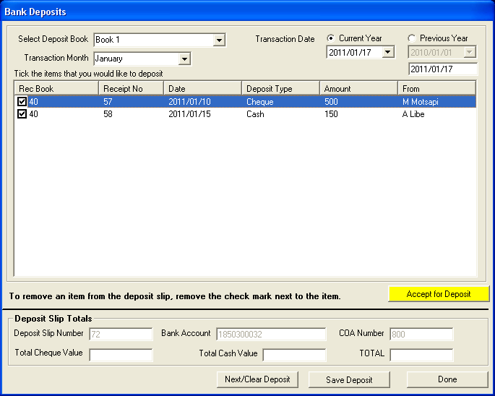
Deposit receipts

Slide 60
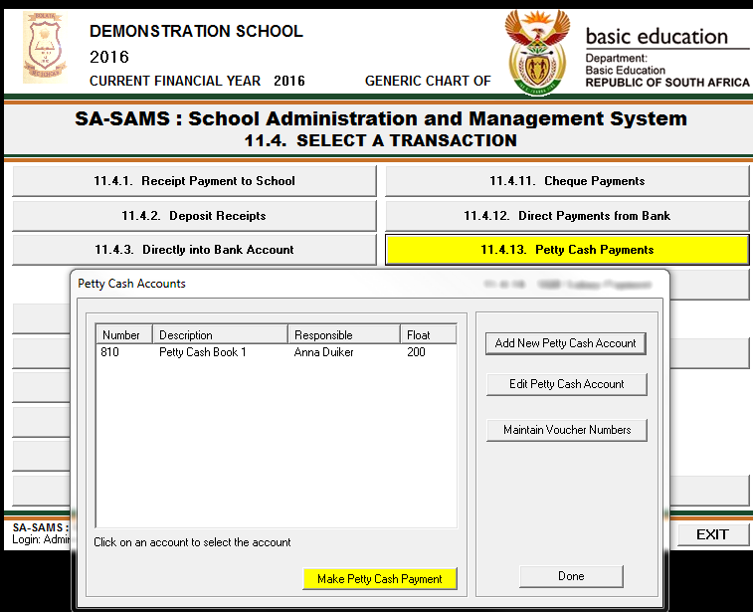
Petty Cash Payments

Slide 61
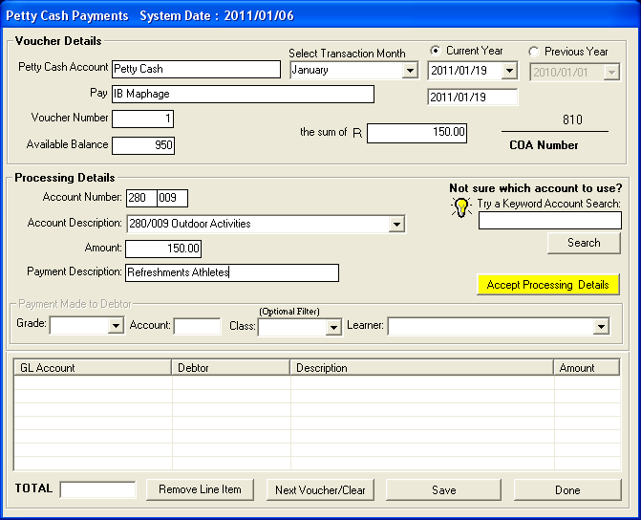
Petty Cash

Slide 62
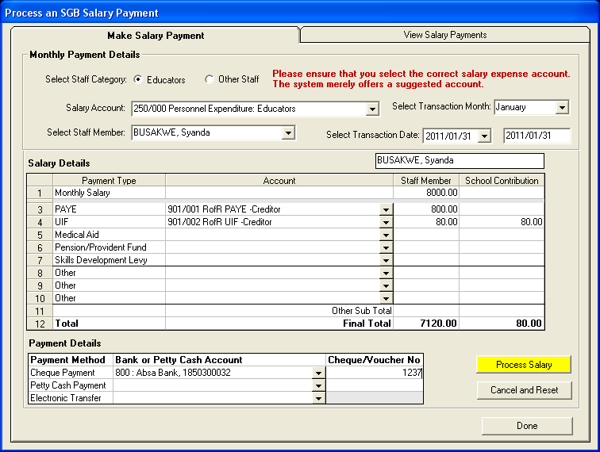
Make salary Payments / SGB Salary

Slide 63
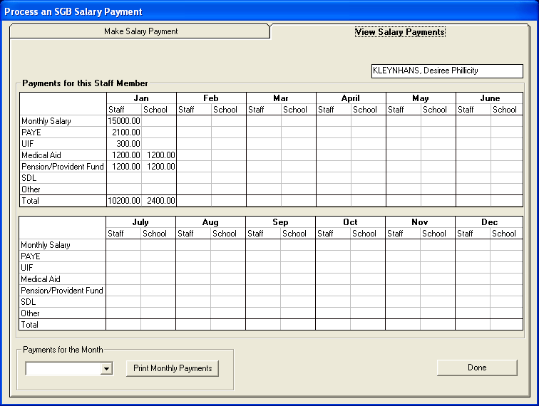
View Salary Payments

Slide 64
CANCELL UNUSED CHEQUE
Only for manual mistakes in books (hardcopies)
Go to System Setup
Maintain Cheque Books
Maintain Cheque Series
Click on the Book to be edited
Click on Cancel Unused Cheque
Complete the window
Save.
Similar steps to be followed for Receipts; Deposits etc.

Slide 65
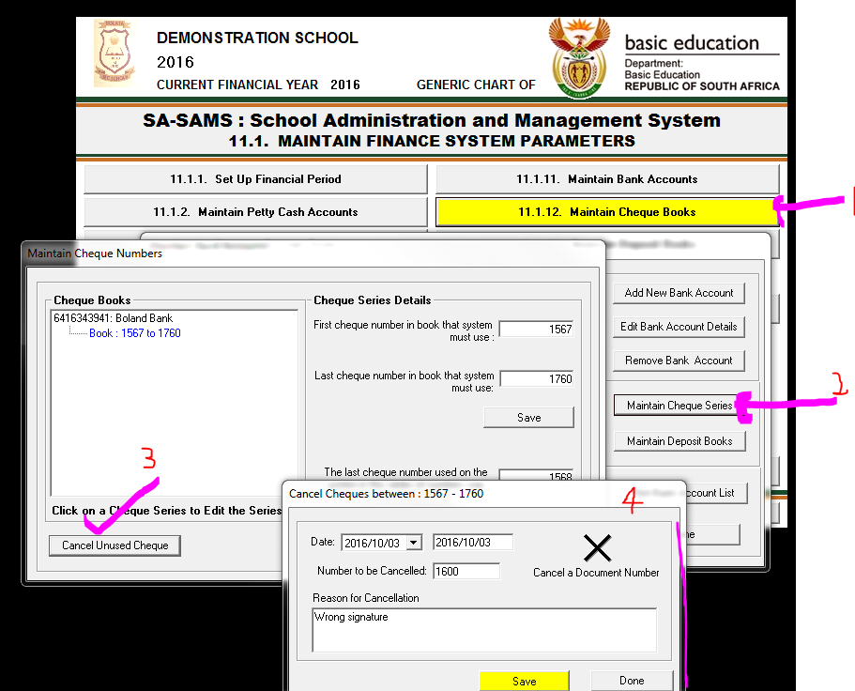
Cancel unused cheque

Slide 66
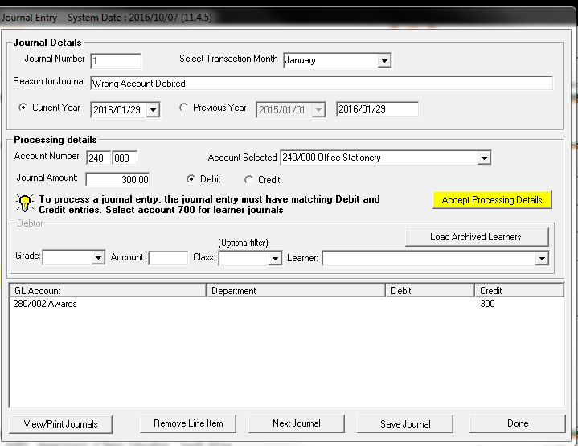
Journal Entry – Credit the account that was wrongly debited

Slide 67
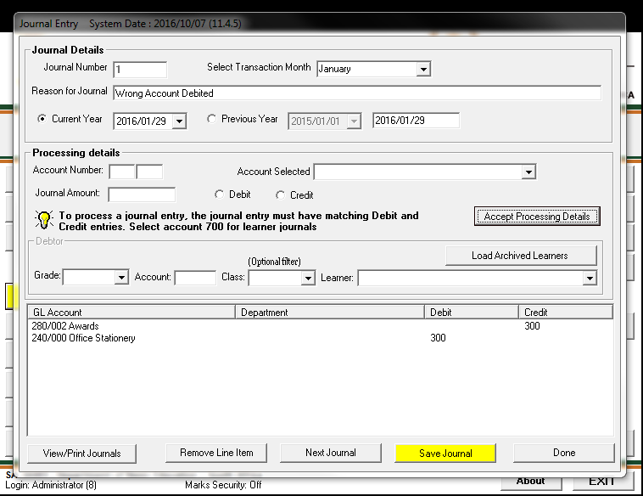

Slide 68

View Journal Entries

Slide 69
Delete Transactions / Error Correction
This action can only be done if not yet reconciled
This is done when a Reversal of a transaction is required.
Type of items to be reversed : Cheque Payment; Receipts; Petty Cash Payment; Deposits; Direct Receipts; Direct Payments from Bank.
Select type of items to be reversed.
Click on item to be reversed
Select Recycle this item

Slide 70


Delete Transaction

Slide 71

Re-process Deleted Items

Slide 72

Re-process

Slide 73

Log of re-processed transaction

Slide 74

Bank Reconciliation

Slide 75

Bank Reconciliation

Slide 76

Debtors and School Fees

Slide 77

Maintain School Fees

Slide 78

Take on balances – this is the amount that a learner still owes the school from previous year

Slide 79

Learner Billing

Slide 80

School Fees Exemptions

Slide 81

History of outstanding fees (Age analysis)

Slide 82

Outstanding fees according to class

Slide 83

Individual learner statements

Slide 84

Print Learner Statement

Slide 85

Learner Statement per learner

Slide 86

Account payer statement – Where more than one learner in family

Slide 87

View General Ledger

Slide 88

General Ledger Reports

Slide 89

View Cash Book

Slide 90

View Financial Statements

Slide 91

View Trial Balance

Slide 92

Year End Functions

Slide 93

Year end Functions

Slide 94

Type in outstanding amount in the write off column

Slide 95

Process Year End Transactions
Confirm compulsory steps and Run Year End

Slide 96


Follow instructions on the Pop Up Menus

Slide 97

The period is now closed and you have to Add a New Period

Slide 98
What if you have been playing around on the financial module and made a total mess???

Slide 99

To delete all data and start afresh click on Year End Function and then on Delete Archived Data

Slide 100

Then click on Delete All. You will now have to Setup a complete new System.

Slide 101


You will get the following messages.

Slide 102

Make very sure that you have made a backup of your database before you delete all.

Slide 103

You will now have to start afresh as explained at the beginning of this presentation.

Slide 104
Thank You

